Slide 1
Genomics for Cancer Clinicians
6-session practical course
Genomics into
Medicine

Slide 2
Acknowledgements
This course is the work of a large team:
Cris Print
Ben Lawrence
Polona Le Quesne Stabej
Sandra Fitzgerald
Ana Ramachandran
Alice Minhinnick
Sylvie Chan
Alex Henderson
Kelly Sullivan
Tamsin Robb
Thierry Lints
Kimi Henare
Vicky Fan
Nadia Hitchen
Angela Mweempwa
Sanjeev Deva
Laird Cameron
James Opie

Slide 3
Interactive session Dr Polona Le Quesne Stabej Dr Anassuya Ramachandran Dr Laird Cameron
Session 6:

Slide 4
54 yo male
Lung adenocarcinoma
HepB
Carboplatin/ Pemetrexed
(6 cycles)
Carboplatin/Paclitaxel/
Bevacizumab/
Atezolizumab
Osimertinib/Crizotinib
SABR to right superior pubic ramus. ZA.
Erlotinib
Osimertinib
CT chest – large L pleural effusion with left lower lobe primary
Low volume progression
Peritoneal progression
(After initial good response)
Oligoprogression at pubic bone/single peritoneal nodule
Peritoneal nodule biopsy – FoundationOne CDx
EGFR p.L858R
BAP1 loss
MET amplification (equivocal)
Axilla lymph node biopsy – FoundationOne
EGFR p.L858R
BAP1 loss
Peritoneal nodule biopsy – FoundationOne CDx
EGFR p.L858R
BAP1 loss
MET Y1230H
Months from diagnosis

Slide 5
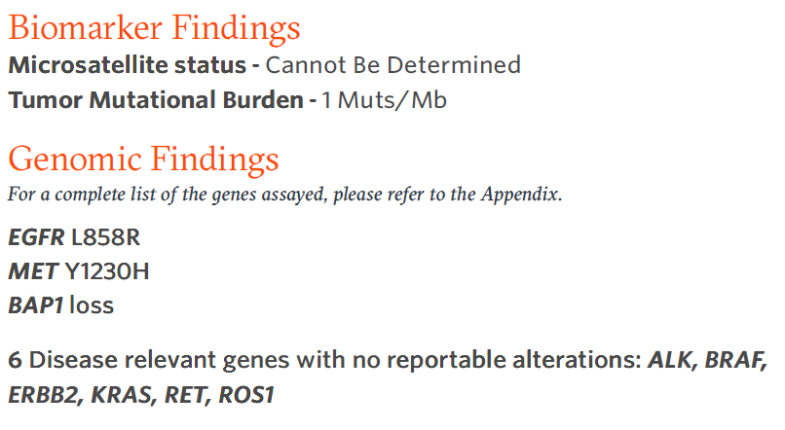
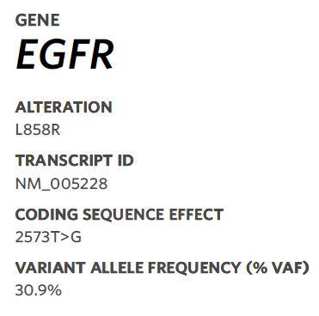
Male, 54 years. Never smoked. PMHx: HepB.
Stage IVb EGFR mutated lung adenocarcinoma with nodal, pleura, peritoneal and bone mets. Progressing on 5th line treatment, 4 years after diagnosis. ECOG 0.

Slide 6
Sequence Variant Nomenclature: HGVS
Gene
Transcript
Coding DNA
Protein
EGFR NM_005228.5: c.2573T>G p.(Leu858Arg) or p.(L858R)
http://varnomen.hgvs.org/
Notes:
Genomic DNA:
chr7:g.140,453,136A>T (GRCh37) or
NM_000007.13:g.140,453,136A>T or
NC_000007.14:g.140753336A>T
https://variantvalidator.org

Slide 7
Functional &
biological
impact
Somatic databases
Benign
Likely Benign
COSMIC
Effect on gene function?
Literature
Effect on protein function?
Variant of
Uncertain
Significance
in vitro
in vivo
Role in mol. signaling?
Likely Oncogenic
General population dbs.
in silico
Oncogenic
From: Horak et al., Genet Med., 2022

Slide 8
Variant nomenclature EGFR p.Leu858Arg
Chromosome 7
g.55259515
EGFR
genomic DNA
Exon 20
Intron 20
….GGG CTG GCC ….
Intron 21
Exon 22
Exon 23
Transcription & Splicing
c.2573
Coding DNA (mRNA)
NM_005228.5
ATG
………. GGG
CTG
GCC
TAA
………..
5’UTR
3’UTR
Translation
p.Leu858
Protein
Met
Leu
Stop

Slide 9
Chromosome 7
g.55259515T>G
EGFR
genomic DNA
Exon 20
Intron 20
….GGG CGG GCC ….
Intron 21
Exon 22
Exon 23
Transcription & Splicing
c.2573T>G
Coding DNA (mRNA)
ATG
………. GGG
CGG
GCC
TAA
………..
5’UTR
3’UTR
Translation
?
EGFR p.L858R
Missense variant in Exon 21
p.Leu858Arg (p.L858R)
Protein
Met
Arg
Stop

Slide 10
Oncogene
EGFR: oncogene, receptor tyrosin kinase
Missense variant/mutation in exon 21
VAF=30.9% (2020 test)
Cancer-promoting
Chromosome 7
EGFR p.L858R
EGFR (normal/ wild type)
?
Functional &
biological
impact
Effect on protein function?
Role in mol. signaling?
Turns on an accelerator for tumour growth

Slide 11
General population dbs.
Lung adenocarcinoma
Gene variant EGFR c.2573T>G, p.L858R
General Population | gnomAD | www.gnomad.broadinstitute.org Search: 7-55259515-T-G
Cancer Databases | Cancer Hotspot | www.cancerhotspots.org Search: EGFR L858R
 | COSMIC | https://cancer.sanger.ac.uk/ Search: EGFR c.2573T>G
Disease Databases | ClinVar | https://www.ncbi.nlm.nih.gov/clinvar/ Search for: NM_005228.5(EGFR):c.2573T>G
Cancer databases
General population dbs.
Genomic var. – Disease dbs

Slide 12
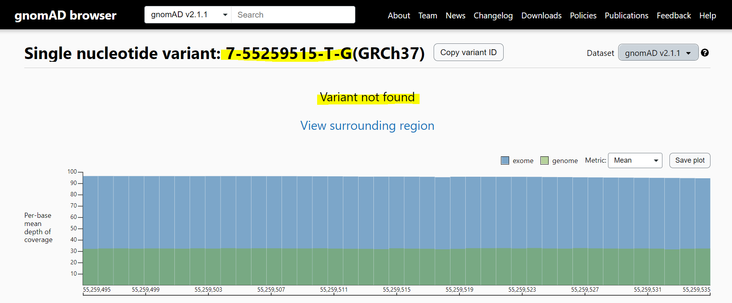

Slide 13
General population dbs.
Lung adenocarcinoma
Gene variant EGFR c.2573T>G, p.L858R
General Population | gnomAD | www.gnomad.broadinstitute.org Search: 7-55259515-T-G
Cancer Databases | Cancer Hotspot | www.cancerhotspots.org Search: EGFR L858R
 | COSMIC | https://cancer.sanger.ac.uk/ Search: EGFR c.2573T>G
Disease Databases | ClinVar | https://www.ncbi.nlm.nih.gov/clinvar/ Search for: NM_005228.5(EGFR):c.2573T>G
Cancer databases
General population dbs.
Genomic var. – Disease dbs

Slide 15
General population dbs.
Lung adenocarcinoma
Gene variant EGFR c.2573T>G, p.L858R
General Population | gnomAD | www.gnomad.broadinstitute.org Search: 7-55259515-T-G
Cancer Databases | Cancer Hotspot | www.cancerhotspots.org Search: EGFR L858R
 | COSMIC | https://cancer.sanger.ac.uk/ Search: EGFR c.2573T>G
Disease Databases | ClinVar | https://www.ncbi.nlm.nih.gov/clinvar/ Search for: NM_005228.5(EGFR):c.2573T>G
Cancer databases
General population dbs.
Genomic var. – Disease dbs

Slide 16
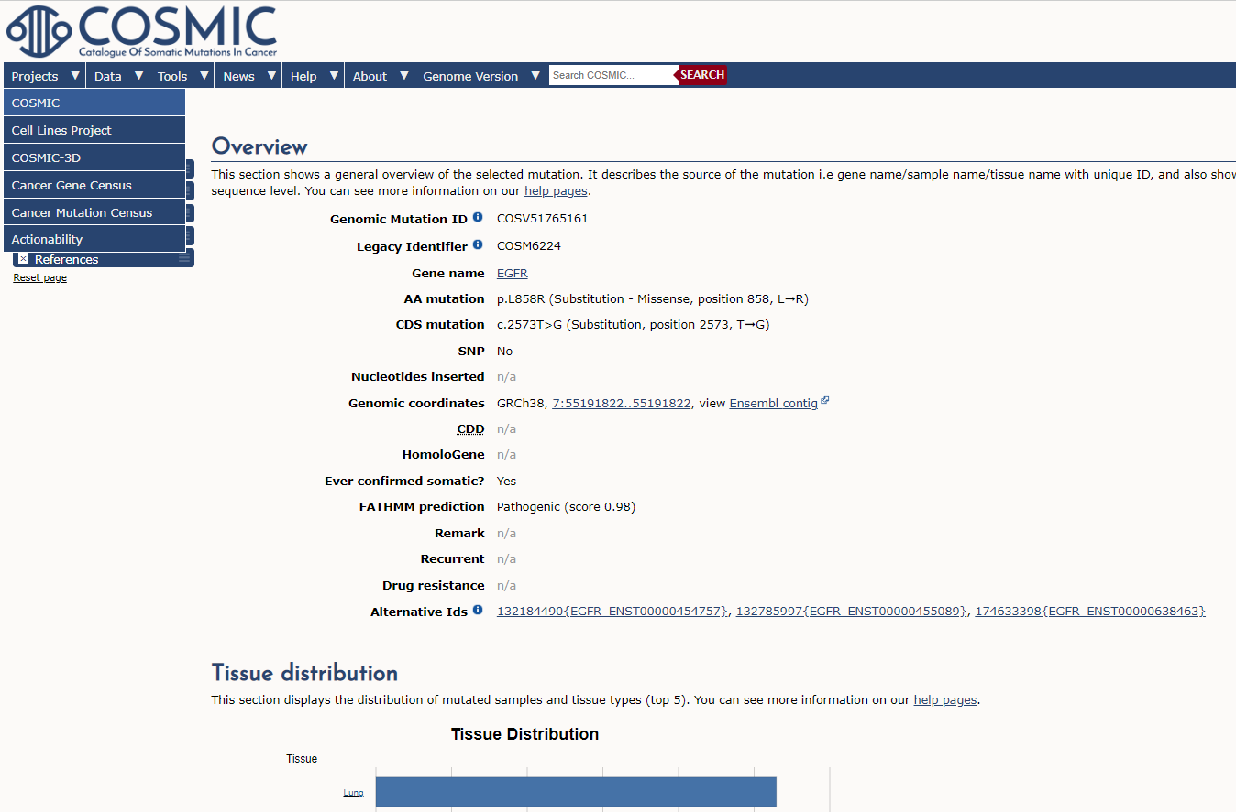
https://cancer.sanger.ac.uk/cosmic/search?q=EGFR+c.2573T%3EG

Slide 17
General population dbs.
Lung adenocarcinoma
Gene variant EGFR c.2573T>G, p.L858R
General Population | gnomAD | www.gnomad.broadinstitute.org Search: 7-55259515-T-G
Cancer Databases | Cancer Hotspot | www.cancerhotspots.org Search: EGFR L858R
 | COSMIC | https://cancer.sanger.ac.uk/ Search: EGFR c.2573T>G
Disease Databases | ClinVar | https://www.ncbi.nlm.nih.gov/clinvar/ Search for: NM_005228.5(EGFR):c.2573T>G
Cancer databases
General population dbs.
Genomic var. – Disease dbs

Slide 18
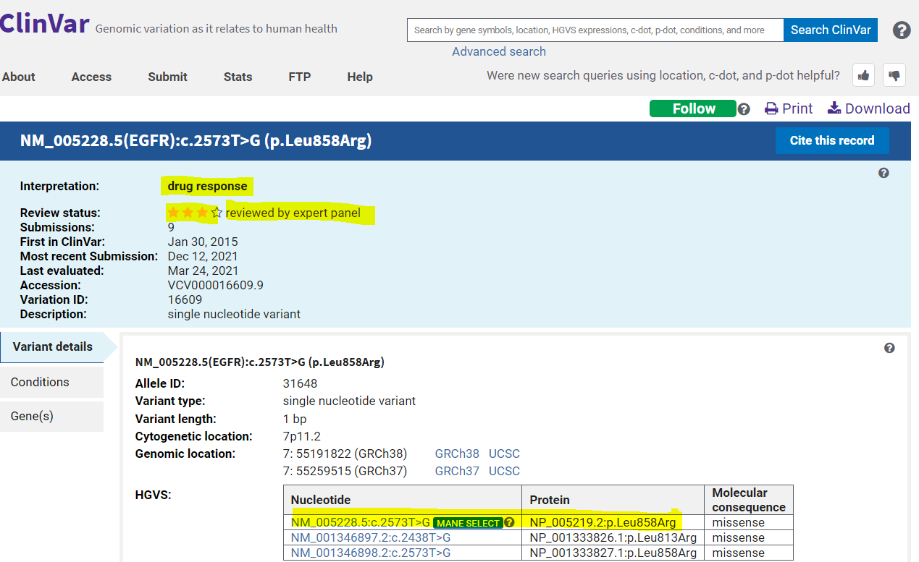

Slide 19
Male, 54 years; Lung adenocarcinoma
Gene variant EGFR c.2573T>G, p.L858R, VAF=30%)
General Population | GnomAD | ✗
Cancer Databases (somatic variants) | Cancer Hotspot COSMIC | ✓ 144 samples (143x lung, 1x Bowel) ✓ 2564 Lung cancer samples
Disease Databases (somatic and germline) | ClinVar | ✓ Yes, pathogenic somatic 7x; germline 1x
In silico |  | SIFT: Pathogenic, Polyphen: probably damaging, CADD=28.1 (High), LRT: damaging, FATTHM: damaging / Agree V600E is pathogenic
In vitro/in vivo |  | Gain-of-function, oncogenic
Somatic/Germline? |  | Likely Somatic (based on VAF and databases)
Pathogenicity

Slide 20
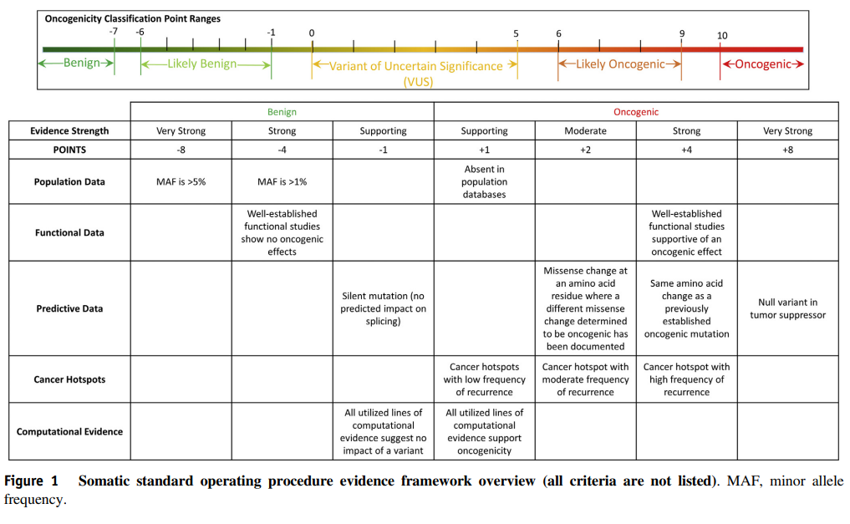
From: Horak et al., Genet Med., 2022

Slide 21
Male, 52 years; Lung adenocarcinoma
Gene variant EGFR c.2573T>G, p.L858R
General Population | GnomAD | ✗
Cancer Databases (somatic variants) | Cancer Hotspot COSMIC | ✓ 144 samples (143x lung, 1x Bowel) ✓ 2564 Lung cancer samples
Disease Databases (somatic and germline) | ClinVar | ✓ Yes, pathogenic somatic 7x; germline 1x
In silico |  | SIFT: Pathogenic, Polyphen: probably damaging, CADD=28.1 (High), LRT: damaging, FATTHM: damaging / Agree V600E is pathogenic
In vitro/in vivo |  | Gain-of-function, oncogenic
Somatic/Germline? |  | Likely Somatic?
Pathogenicity |  | Oncogenic

Slide 22
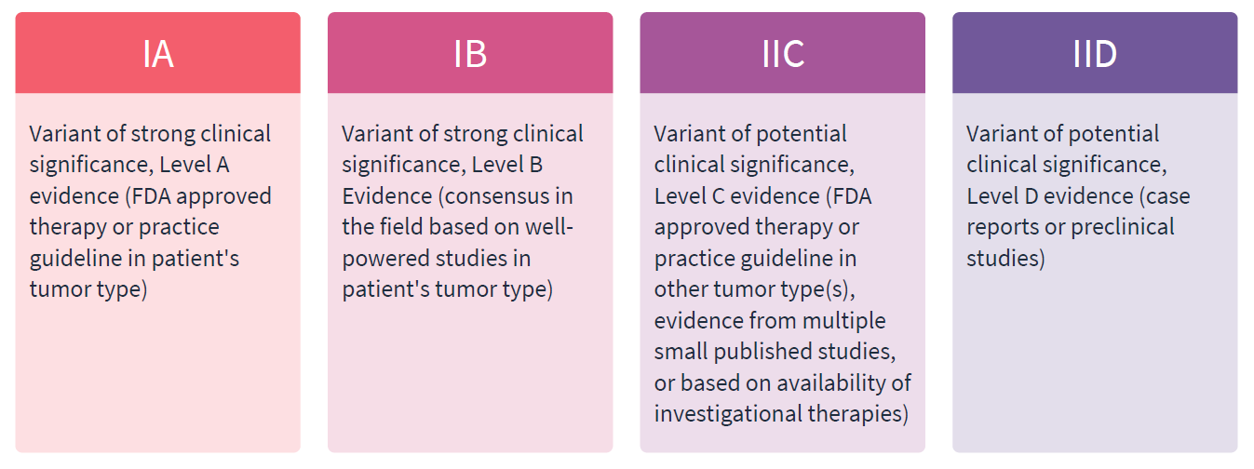
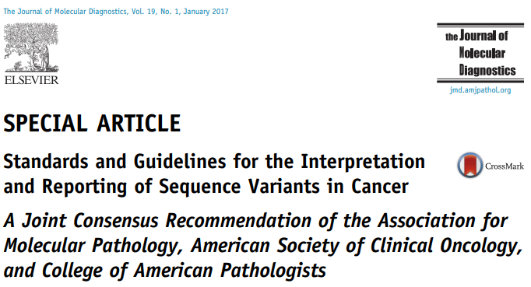

Slide 23
Gene variant EGFR p.(L858R)
Cancer Databases (somatic variants) | CiViC | https://civicdb.org/welcome Search: EGFR L858R
 | ONCOKb | https://www.oncokb.org/ Search: EGFR L858R
Publications |  | BEACON study (Tabernero et al 2021; Journal of Clinical Oncology 2021 39:4, 273-284)
Somatic/Germline?
Clinical significance

Slide 24
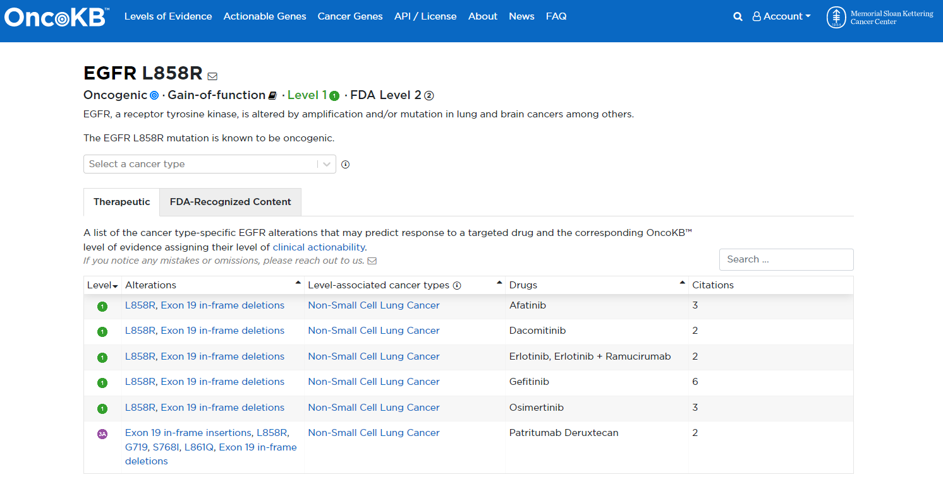

Slide 25
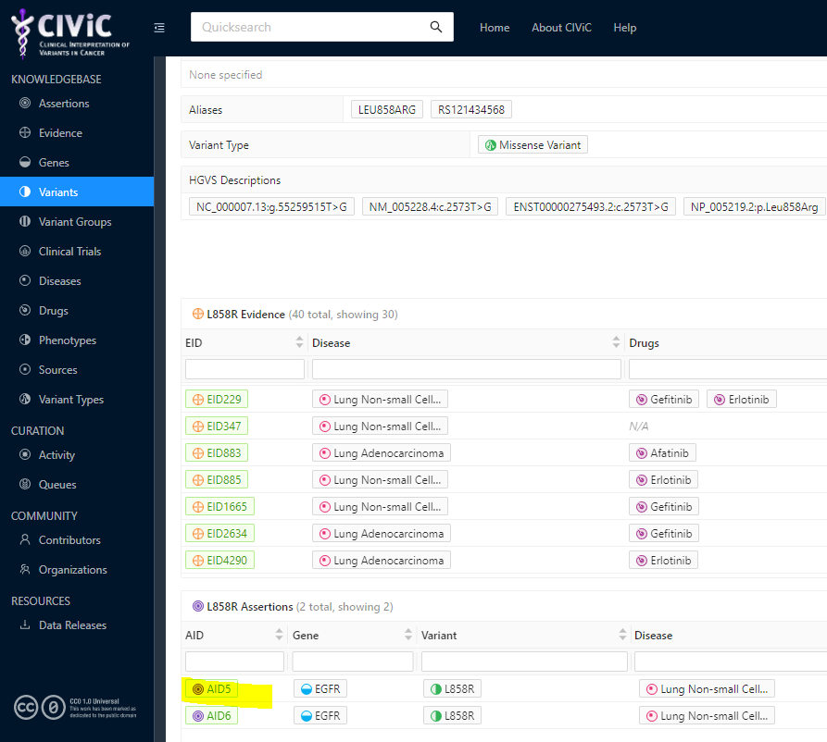
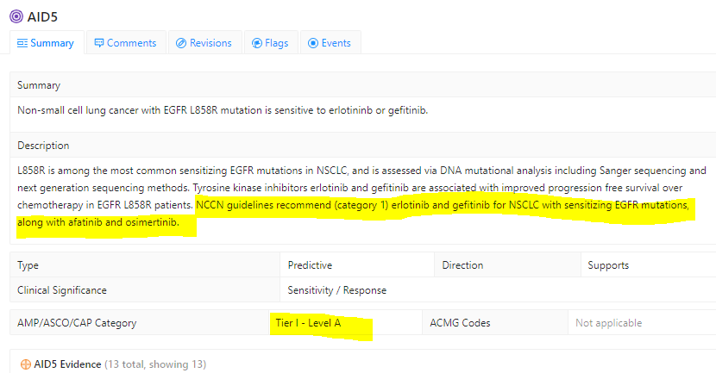
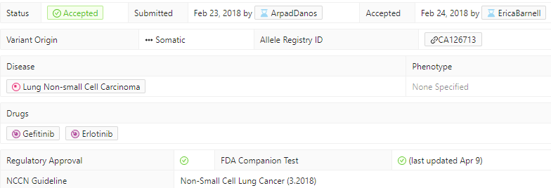
https://civicdb.org/variants/33/summary

Slide 26
 | Alteration | Origin | Significance | Potential benefit | Level of evidence | Access
EGFR | p.L858R | Likely Somatic | Oncogenic | Targeted treatment | IA | Funded

Slide 27
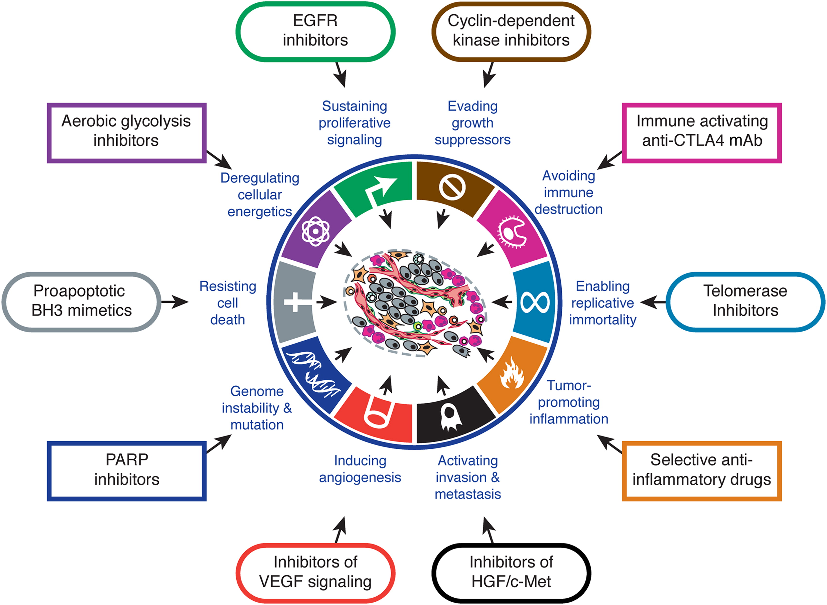
Hallmarks of Cancer
Distilled into the hallmarks of cancer:
Hi ana … OK if I download slides?
Concepts are shared by many cases but the detail is unique to an individual
Hanahan, D. and Weinberg, R.A. 2011. Cell. 144: 646-674

Slide 28
Tumour Evolution
Tumours are continually evolving, either by genetic drift or Darwinian selection
Therapy applies a strong selective pressure on cells
Timing of genomic test and material sampled are important and should be active choices

Slide 29
54 yo male
Lung adenocarcinoma
HepB
Carboplatin/ Pemetrexed
(6 cycles)
Carboplatin/Paclitaxel/
Bevacizumab/
Atezolizumab
Osimertinib/Crizotinib
SABR to right superior pubic ramus. ZA.
Erlotinib
Osimertinib
CT chest – large L pleural effusion with left lower lobe primary
Low volume progression
Peritoneal progression
(After initial good response)
Oligoprogression at pubic bone/single peritoneal nodule
Peritoneal nodule biopsy – FoundationOne CDx
EGFR p.L858R
BAP1 loss
MET amplification (equivocal)
Axilla lymph node biopsy – FoundationOne
EGFR p.L858R
BAP1 loss
Peritoneal nodule biopsy – FoundationOne CDx
EGFR p.L858R
BAP1 loss
MET Y1230H
Months from diagnosis

Slide 30
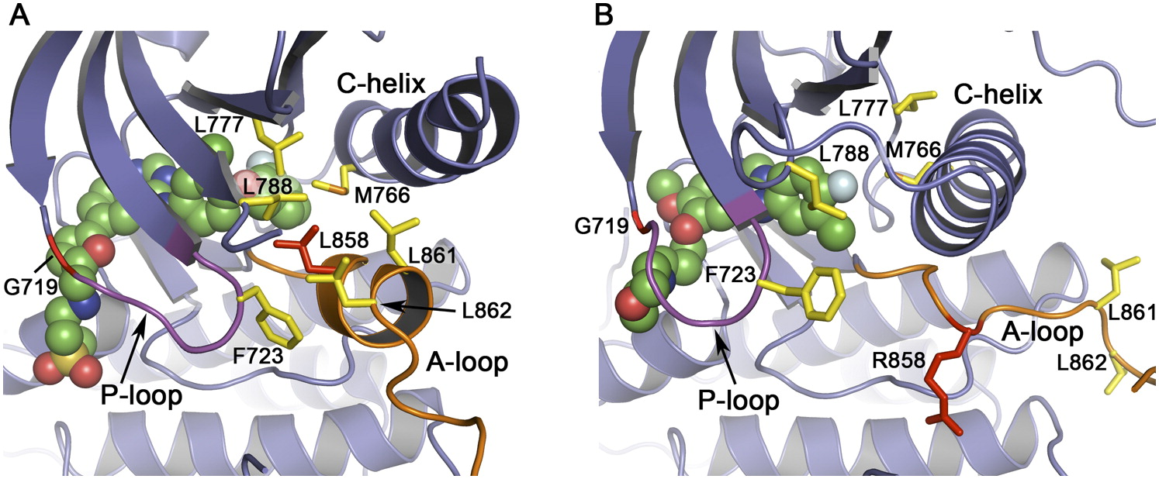
EGFR p.L858R is more Active than Wildtype
EGFR is a receptor tyrosine kinase (RTK) – a receptor with enzymatic activity
EGFR p.L858R locks EGFR in an active conformation
EGFR p.L858R sensitive to inhibition by Erlotinib
Yun, C-H. et.al. 2007. Cancer Cell. 11: 217-227
Ji, H. et.al. 2006. PNAS. 103: 7817-7822

Slide 31
EGFR and MET Interplay
Multiple RTK pathways activate shared downstream effectors
MET amplification account for 5-20% of acquired resistance to EGFR TKI
Wu, Y-L. et.al. 2017. Cancer Treatment Reviews. 61: 70-81

Slide 32
54 yo male
Lung adenocarcinoma
HepB
Carboplatin/ Pemetrexed
(6 cycles)
Carboplatin/Paclitaxel/
Bevacizumab/
Atezolizumab
Osimertinib/Crizotinib
SABR to right superior pubic ramus. ZA.
Erlotinib
Osimertinib
CT chest – large L pleural effusion with left lower lobe primary
Low volume progression
Peritoneal progression
(After initial good response)
Oligoprogression at pubic bone/single peritoneal nodule
Peritoneal nodule biopsy – FoundationOne CDx
EGFR p.L858R
BAP1 loss
MET amplification (equivocal)
Axilla lymph node biopsy – FoundationOne
EGFR p.L858R
BAP1 loss
Peritoneal nodule biopsy – FoundationOne CDx
EGFR p.L858R
BAP1 loss
MET Y1230H
Months from diagnosis

Slide 33
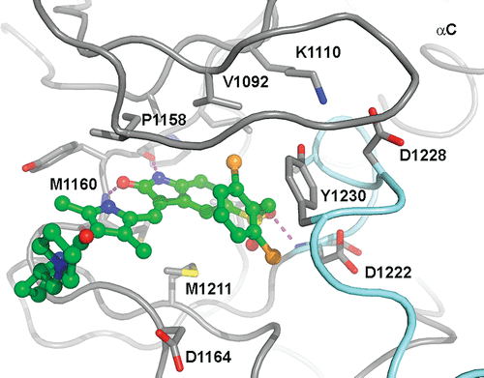
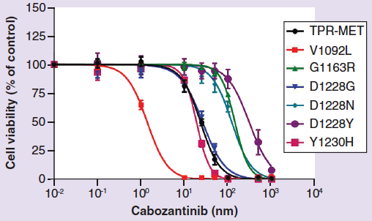
Acquired Resistance to METi (MET p.Y1230H)
Y1230 involved in Type I METi (e.g. Crizotinib) stacking into ATP binding pocket
Type II METi (Glesatinib, Merestinib, Cabozantinib) show efficacy to some MET mutants
Cui, J.J. et.al. 2011. J. Med. Chem. 54: 6342-6363.
Engstrom, L.D. et.al. 2017. Clinical Cancer Research. 23: 6661-6672.
Shen, B. et.al. 2019. Future Oncology. 15: 2585-2593.

Slide 34
54 yo male
Lung adenocarcinoma
HepB
Carboplatin/ Pemetrexed
(6 cycles)
Carboplatin/Paclitaxel/
Bevacizumab/
Atezolizumab
Osimertinib/Crizotinib
SABR to right superior pubic ramus. ZA.
Erlotinib
Osimertinib
CT chest – large L pleural effusion with left lower lobe primary
Low volume progression
Peritoneal progression
(After initial good response)
Oligoprogression at pubic bone/single peritoneal nodule
Peritoneal nodule biopsy – FoundationOne CDx
EGFR p.L858R
BAP1 loss
MET amplification (equivocal)
Axilla lymph node biopsy – FoundationOne
EGFR p.L858R
BAP1 loss
Peritoneal nodule biopsy – FoundationOne CDx
EGFR p.L858R
BAP1 loss
MET Y1230H
Months from diagnosis

Slide 35
 | Alteration | Origin | Significance | Potential benefit | Level of evidence | Access
BAP1 | loss | Somatic* | Pathogenic | Targeted treatment | IID
EGFR | L858R | Somatic* | Pathogenic | Targeted treatment | IA | Funded
MET | Amplification (equivocal) | Somatic* | Pathogenic | Treatment resistance | IIC
MET | Y1230H | Somatic* | Pathogenic | Treatment resistance | IID | Not funded No clinical trials
Notes:
https://www.ncbi.nlm.nih.gov/pmc/articles/PMC8674488/

Slide 36
Sessions recap
Session 1 | Essential genetics and genomics for clinical practice Dr Polona Le Quesne Stabej, University of Auckland
Session 2 | Practical variant interpretation Dr Polona Le Quesne Stabej, University of Auckland
Session 3 | Using next generation genomic tests Dr Sandra Fitzgerald, University of Auckland
Session 4 | Cancer biology matters for precision oncology Dr Ana Ramachandran, University of Auckland
Session 5 | Inherited Cancer Predisposition Dr Alex Henderson, Ms Kelly Sullivan, Auckland District Health Board
Session 6 | Interactive session Dr Polona Le Quesne Stabej, Dr Ana Ramachandran, Dr Laird Cameron

Slide 37
Any questions?

Slide 38
https://www.genomicsinmedicine.auckland.ac.nz/medical-professionals/

Slide 39
Survey
https://qfreeaccountssjc1.az1.qualtrics.com/jfe/form/SV_1NTbZhMT0wEhAlo
Thank you!
Genomics into
Medicine

Slide 40
End
Genomics into
Medicine

