Slide 1
Genomics for Cancer Clinicians
6-session practical course
Genomics into
Medicine

Slide 3
Acknowledgements
This course is the work of a large team:
Cris Print
Ben Lawrence
Polona Le Quesne Stabej
Alice Minhinnick
Sylvie Chan
Sandra Fitzgerald
Ana Ramachandran
Alex Henderson
Kelly Sullivan
Tamsin Robb
Thierry Lints
Kimi Henare
Vicky Fan
Nadia Hitchen
Angela Mweempwa
Sanjeev Deva
Laird Cameron
James Opie

Slide 4
Schedule
Session 1 | Essential genetics and genomics for clinical practice Dr Polona Le Quesne Stabej, University of Auckland | 2pm, May 27th 2022
Session 2 | Practical variant interpretation Dr Polona Le Quesne Stabej, University of Auckland | 2pm, June 3rd 2022
Session 3 | Using next generation genomic tests Dr Sandra Fitzgerald, University of Auckland | 2pm, June 10th 2022
Session 4 | Cancer biology matters for precision oncology Dr Ana Ramachandran, University of Auckland | 2pm, July 8th 2022
Session 5 | Inherited Cancer Predisposition Dr Alex Henderson, Auckland District Health Board | 2pm, August 2nd 2022
Session 6 | Interactive session | 2pm, August 9th 2022

Slide 5
Inherited Cancer Predisposition Dr Alex Henderson, clinical geneticist Ms Kelly Sullivan, genetic counsellor Dr Polona Le Quesne Stabej
Session 5:

Slide 6
Germline variants
Somatic variants
Variant in egg or sperm
ACATTCCTCTT
ACATTCATCTT
ACATTCCTCTT
ACATTCCTCTT
All cells have the variant / ’mutation’
ACATTCCTCTT
ACATTCATCTT
ACATTCCTCTT
ACATTCATCTT
Variant in one cell and its daughter cells
Heritable
Not inherited

Slide 7
Somatic
Suspected germline var. detected via tumour sequencing
Clinical suspicion
Germline
Tumour testing/sequencing
Certain cancers
Early onset, multiple primaries
Multiple affected relatives
Genetic services
Genetic services
Therapeutic
Prognostic Diagnostic
Confirmation of germline variant
Gene panels (tumour type dependent)
Return of results via Genetic Services
Tumour-based testing for the detection of germline variants is less sensitive than blood-based testing

Slide 8
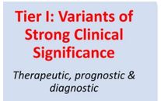
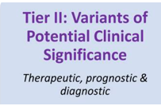
Role of Variant Interpretation / Curation
BRAF normal/wt
Horak et al. Genet Med 2022
Li et al. J Mol Diagn 2017
Benign
Likely Benign
VUS
Likely Oncogenic
Oncogenic
Diagnostic
Prognostic
Therapeutic
BRAF p.Val600Glu
Oncogenicity assessment
Clinical significance?
Somatic origin
ACMG Guidelines: Richards et al. Genet Med 2015
Testing for the family
BRCA2
p.Glu881Ter
Benign
Likely Benign
VUS
Likely Pathogenic
Pathogenic
Cancer surveillance Early Detection
BRCA2
p.Glu881Ter
Pathogenicity assessment
Clinical significance?
Cancer prevention
Personalised treatment
Germline origin
Reproductive decisions

Slide 9
Pathogenicity classification of germline variants
ACMG Guidelines Richards S, et al. Genet Med. 2015 May;17(5):405-24. doi:10.1038/gim.2015.30. PMID: 25741868
Probability of pathogenicity
0.1%
0.1-10%
10-90%
90-99%
>99%
Benign
Variant of Uncertain Significance
(VUS)
Pathogenic
Likely Benign
Likely Pathogenic
Lines of evidence for/against pathogenicity
Frequency in the general population (gnomAD)
‘Disease databases’: ClinVar, LOVD
Type of variant
Functional data:
Computational data (in silico)
in vitro/in vivo experiment
Segregation with the phenotype
Reported | Clinically actionable

Slide 10
Case 1: 32y M early-stage renal cell carcinoma (RCC)
PC: haematuria in normally well young man
USS: 4cm complex cystic renal mass
CT CAP: bilateral kidney lesions, pancreatic lesion, vascular spinal lesion
Biopsy renal mass: RCC, low grade
Stage IV disease
FHx: father renal cancer, paternal aunty brain tumour, paternal uncle described as sweaty and tremulous and who died of unknown cause
Question: any further workup recommended?

Slide 11
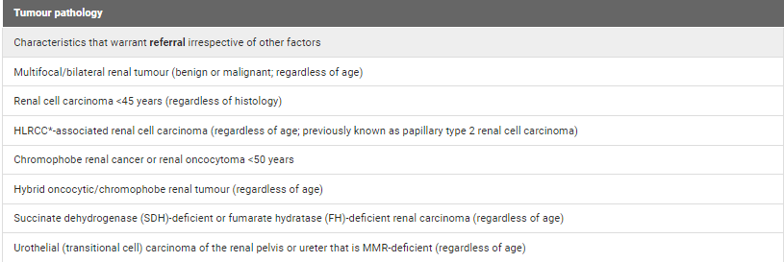

Slide 12
Case 1: 32y M early stage renal cell carcinoma (RCC)
PC: haematuria in normally well young man
USS: 4cm complex cystic renal mass
CT CAP: bilateral kidney lesions, pancreatic lesion, vascular spinal lesion
Biopsy renal mass: RCC, low grade
??stage IV disease
FHx: father renal cancer, paternal aunty brain tumour, paternal uncle described as sweaty and tremulous and who died of unknown cause.
Question: any further workup recommended?
Refer to genetic services

Slide 13
Clinical genetic testing in Ao/NZ
Genetic Health Service NZ
Genetic counsellors/clinical geneticist
Pretest/post test counselling
On-call service for referrers
Private sector
Mainstreaming

Slide 14
Pedigree

Slide 15
Pre-test counselling
Data sovereignty/ return of tissue
Future cancer risk
Extended whānau
Insurance
Timing/coping
Sample type
Children
Meaning-making

Slide 16
Case 1: Familial cancer panel sequencing results
FAMILIAL CANCER PANEL REPORT
Gene | Nucleotide variant | Protein Variant | Classification
VHL | NM_000551.4:c.482G>A | p.Arg161Gln | Pathogenic
Clinical Interpretation
DNA sequence analysis of the VHL gene demonstrated a sequence change, c.482G>A, in exon 3 that results in an amino acid change, p.Arg161Gln. This sequence change is absent from large population databases such as gnomAD. This pathogenic sequence change has previously been described in multiple patients and families with Von Hippel-Lindau syndrome (Igaki et al., 2018; Zhang et al., 2015; Iada et al., 2004). In at least one individual the variant was observed to be de novo. It has also been observed to segregate with disease in related individuals. Functional analyses demonstrated that the p.Arg161Gln change inhibits the VHL protein from binding to proline-hydroxylated hypoxia-inducible factor 1A (HIF1a peptide (Couve et al., 2014)). The p.Arg161Gln change affects a highly conserved amino acid residue located in a domain of the VHL protein that is known to be functional. The p.Arg161Gln substitution appears to be deleterious using several in-silico pathogenicity prediction tools (SIFT, PolyPhen2, CADD, REVEL).

Slide 17
Variant curation (ACMG guidelines)
SNV
Missense change
VHL (tumour suppressor) | NM_000551.4:c.482G>A p.Arg161Gln
Population Databases GnomAD |  | PM2 strong
Databases ClinVar | Yes, multiple submitters, no conflicts: Germline, Pathogenic, von Hippel-Lindau syndrome, hereditary cancer predisposition | PP5 support.
Functional in silico | SIFT: deleterious, PolyPhen: probably dam., CADD:32, ClinPred: D, FATHHM: D, LIST: D, LRT: D, M-cap:D MutPred:0.962, REVEL:0.788 / Agree: Deleterious | PP3 mod.
Functional in vitro | Arg161Gln mutants: reduced binding to a proline-hydroxylated HIF-1α peptide … VHL protein loss of function (PMID:25371412) | PS3 support.
Segregation | many papers; PMID:25371412 … | PP1 support.
Literature | Arg161Gln: Type 2A phenotype (severe); missense variants associated with severe (2A, 2B phenotype) or weaker (2C); truncating VHL variants: Type 1 (most severe phenotype)
Somatic/Germline | Germline origin
Classification | Pathogenic
PS1: Same amino acid change as a previously established pathogenic variant
PP4: A patient’s phenotype or family history is highly specific for a disease with a single genetic aetiology

Slide 18
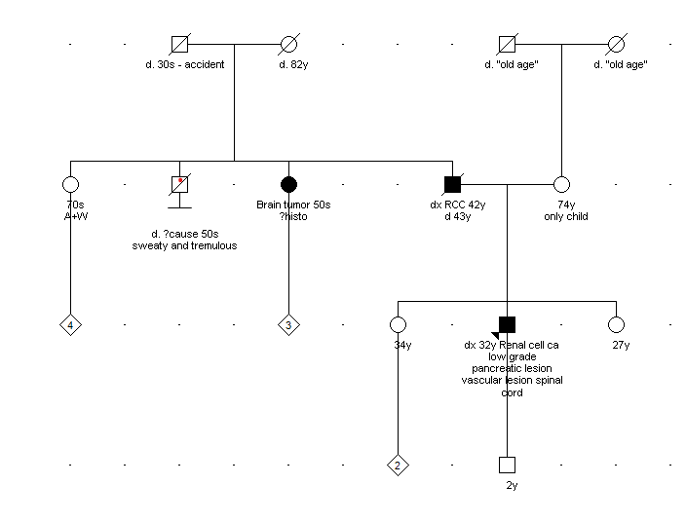
Case 1: Management
RCC – local treatment for stage I disease
Surveillance
Familial recommendations

Slide 19
Case 2: 45F stage II Lung Adenocarcinoma
Previously well teacher, adopted, mother of 2 teenage daughters, 1 son
PC: haemoptysis, CXR hilar mass
PET-CT: primary tumour only, no nodal disease, no mets
Transbronchial biopsy: adenocarcinoma
Lobectomy: curative intent surgery
Tumour tissue sent for NGS (eg using TSO500)
Starts post-op adjuvant chemotherapy
Question:
- during consent for tumour sequencing, what discussion is needed on germline variants?

Slide 20
Pedigree

Slide 21
Genomic test
Site sampled​ | ​lung
Name of test​ | TruSight Oncology 500 (TSO500)
Method​ | Hybridisation capture-based NGS
Number of genes ​ | 523
Variation detected​ | SNVs, CNVs (58 genes), Fusions & splice (RNA) in 55 genes
Distinguishes somatic from germline ​ | No​
TMB | Yes​
MSI​ | Yes

Slide 22
Case 2: TSO500 NGS panel tumour sequencing results
Gene | DNA | Protein | VAF
BRCA2 | NM_000059.4:c.2641G>T | p.(Glu881Ter) | 48%
EGFR | NM_005228.5:c.2156G>C | p.(Gly719Ala) | 30%
INHBA | c.520C>A | p.(Arg174Ser) | 5%
Suspected germline variant?
VAF?
Previously reported as germline?
Phenotype?

Slide 23
Variant curation (ACMG guidelines)
Nonsense/truncating in exon 11
SNV
BRCA2 | NM_000059.4:c.2641G>T p.(Glu881Ter) VAF=48%
Population Databases GnomAD |  | PM2
Databases ClinVar | Reviewed by expert panel (ENIGMA): Pathogenic germline; 5x (BC and Hereditary cancer predisposition syndrome | PP5
Cancer Databases COSMIC, cBioPortal
Consequence | Null (truncating) variant in a gene where LOF is a known mechanism of disease Loss of BRCA2 function is a known mechanism of disease | PVS1
Functional in vitro | BRCA2 LoF variants in exon 11 → PVS1 criteria can be applied (Mesman et al 2020; PMID: 32398771)
Functional in silico | Predicted to undergo nonsense mediated decay Predicted to encode a truncated non-functional protein | PP3
Segregation
Literature | BRCA1 and BRCA2 are tumour suppressor genes with a central role in the homologous recombination repair (HRR) pathway.
Somatic/Germline | Suspected germline
Classification | Pathogenic

Slide 24
Case 2: 45F NSLC Lung Adenocarcinoma
Returns to clinic to discuss NGS panel results
Questions
What are the next steps to confirm these results?
Referral on to GHSNZ

Slide 25
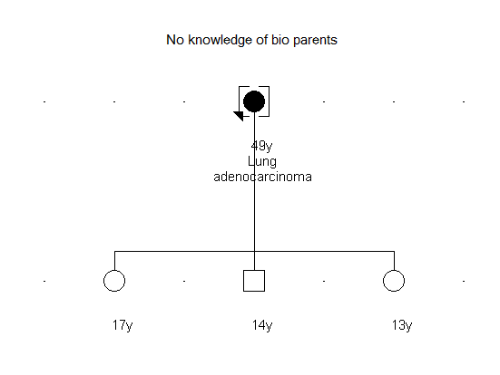
Genetics service
Discuss why BRCA2 and not EGFR variant was suspected germline
Discuss penetrance; cancer predisposition
FAMILIAL CANCER REPORT​ |  |  | ​
Gene​ | Nucleotide variant​ | Protein Variant​ | Classification​
BRCA2​ | NM_000059.4:c.2641G>T ​ | p.(Glu881Ter)​ | Pathogenic​

Slide 26
Germline-focussed analysis of tumour-only sequencing: recommendations from the ESMO Precision Medicine Working Group
D. Mandelker, M. Donoghue, S. Talukdar, C. Bandlamudi, P. Srinivasan, M. Vivek, S. Jezdic, H. Hanson, K. Snape, A. Kulkarni, L. Hawkes, J.-Y Douillard, S.E. Wallace, E. Rial-Sebbag, F. Meric-Bersntam, A. George, D. Chubb, C. Loveday, M. Ladanyi, M.F. Berger, B.S. Taylor, C. Turnbull
Annals of Oncology
Volume 30 Issue 8 Pages 1221-1231 (August 2019)
Largest available dataset of paired tumour-normal sequencing, comprising 17152 unselected cancer patients in whom clinical sequencing of both germline (blood) and tumour samples had been successfully carried out.
Generated :
recommendations regarding germline-focussed analyses of tumour-only sequencing data,
indications for germline follow-up testing and
guidance on patient information-giving and consent.

Slide 27
Key issues relevant to germline-focussed tumour analysis
‘On-tumour’ and ‘Off-tumour’ associations of gene with tumour type
Clinical Actionability
Penetrance of cancer
Tumour heterogeneity and contamination with normal tissue
Threshold for triggering germline follow-up testing
Consent and patient education

Slide 28
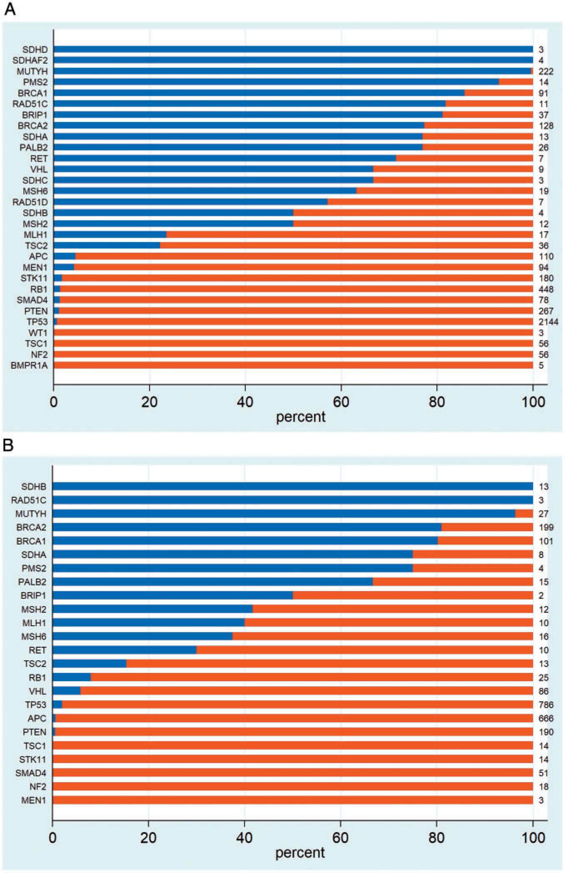
Annals of Oncology 2019 301221-1231DOI: (10.1093/annonc/mdz136)

Slide 29
Actionability of germline variants
High-risk variants:
Guidelines (typically EVIQ)
Surveillance (early detection)
Prevention (risk-reducing surgery)
Personalised treatment (targeted therapy, surgical or chemo)
Testing for the family
Moderate-risk variants:
Heavily influenced by family history
Surveillance – may be less frequent
Prevention risk-reducing surgery typically not recommended for carriers of moderate risk variants
Family testing – cautiously (especially if the management won’t change)
Low-risk variants (polygenic risk scores):
Actionability unclear, particularly in non-pākeha

Slide 30
Recommendations for genes to be included for germline-focussed analysis and triggering of germline sample laboratory confirmation
 | Any tumour type | Associated tumour type only
Tumour arising any age | BRCA1 BRCA2 BRIP1 MLH1 MSH2 MSH6 PALB2 PMS2 RAD51C RAD51D RET SDHA SDHAF2 SDHB SDHC SDHD TSC2 VHLª MUTYH^{b} | FLCN FH BAP1 POLE
Tumour arising age <30 only | RB1 APC | TP53^{c} NF1
a Renal tumours to be excluded.
b MUTYH should be included for germline-focussed tumour analysis but reporting and germline follow-up testing should only be performed on detection of two pathogenic variants.
c Brain tumours to be excluded.
https://www.eviq.org.au/cancer-genetics/resources/4056-considerations-for-germline-testing-for-varia

Slide 31
Somatic
Suspect germline origin:
VAF close to50% (heterozygous variant)
Variant in ‘correct tumour type’ (BRCA in BC)
Founder variants
Tumours at a young age and multiple
independent tumours
Family history of cancer
Suspected germline var. detected via tumour sequencing
Tumour sequencing
Genetic services
Therapeutic
Prognostic Diagnostic
Confirmation of germline variant
Indicated in the sequencing report
Suggested by Molecular Tumour Board
Return of results via Genetic Services
Tumour-based testing for the detection of germline variants is less sensitive than blood-based testing

Slide 32
End
Contact GHSNZ:
0800-476-123
Gensec@adhb.govt.nz
https://www.genetichealthservice.org.nz/

