Slide 1
Genomics for Cancer Clinicians
6-session practical course
Genomics into
Medicine

Slide 2
Schedule
Session 1 | Essential genetics and genomics for clinical practice Dr Polona Le Quesne Stabej, University of Auckland | 2pm, May 27th 2022
Session 2 | Practical variant interpretation Dr Polona Le Quesne Stabej, University of Auckland | 2pm, June 3rd 2022
Session 3 | Using next generation genomic tests Dr Sandra Fitzgerald, University of Auckland | 2pm, June 10th 2022
Session 4 | Cancer biology matters for precision oncology Dr Ana Ramachandran, University of Auckland | 2pm, July 8th 2022
Session 5 | Inherited Cancer Predisposition Dr Alex Henderson, Auckland District Health Board | 2pm, July 15th 2022
Session 6 | Interactive session | 2pm, July 22nd 2022

Slide 3
Acknowledgements
This course is the work of a large team:
Cris Print
Ben Lawrence
Polona Le Quesne Stabej
Sandra Fitzgerald
Alex Henderson
Ana Ramachandran
Tamsin Robb
Thierry Lints
Kimi Henare
Vicky Fan
Alice Minhinnick
Sylvie Chan
Nadia Hitchen
Angela Mweempwa
Sanjeev Deva
James Opie

Slide 4
Cancer Biology in Precision Oncology Dr. Anassuya Ramachandran
Session 4:

Slide 5
Session 4: Cancer Biology in Precision Oncology
Case Overview
Hallmarks of Cancer
Tumour Evolution and Clonal Heterogeneity Emergence of Therapy Resistance

Slide 6
43 yo male
Metastatic CRC
Folfoxiri+
bevacizumab
Encorafenib, binimetinib, cetuximab
Folfoxiri+
bevacizumab
Encorafenib, cetuximab
2021
2019
2020
Colorectal cancer,
liver mets.
Reduction of primary+
liver mets
Lesions sig. reduced
Liver lesions increased
Progressing liver mets and
- bone mets
Liver lesion increased
Sampled - tissue
liver mets.
Sampled – blood/plasma
ctDNA
Foundation One CDx tissue
Foundation One
Liquid Cdx
BRAF V600E
BRAF V600E
NRAS Q61H
BRIP1 R798*
MET – amplification
TP53 559+2T>G (splice)
BRAF V600E
BRAF exons 2-10 deletion
BRIP1 R798*
TP53 559+2T>G (splice)

Slide 7
The Biology of Cancer
Cancer is a multistep process where cells:
Acquire functional capabilities that permit unrestrained cell growth
Share features with embryonic development and wound healing
Tumours are complex, three-dimensional tissues
Cancer cells must implement a series of adaptive stages to successfully metastasise
Hanahan, D. and Weinberg, R.A. 2011. Cell. 144: 646-674

Slide 8
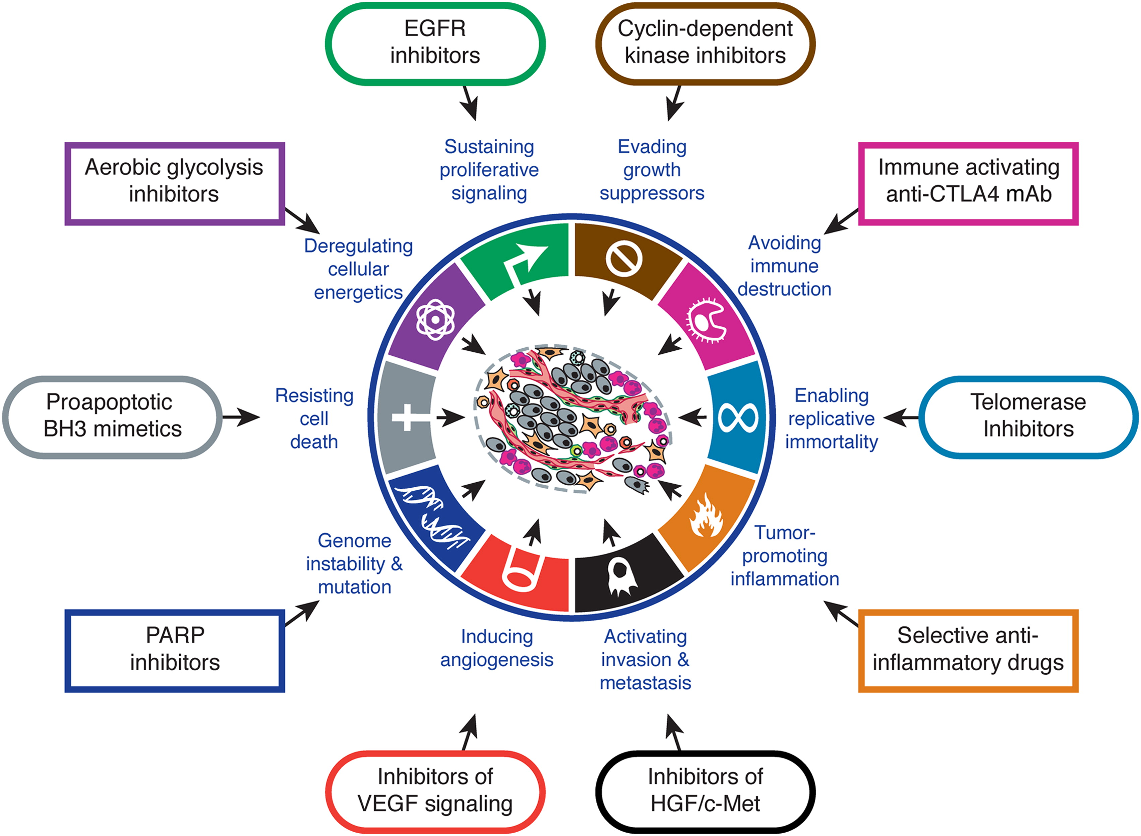
Hallmarks of Cancer
Distilled into the hallmarks of cancer:
Concepts are shared by many cases but the detail is unique to the individual
Hanahan, D. and Weinberg, R.A. 2011. Cell. 144: 646-674

Slide 9
Oncogenes and Tumour Suppressor Genes
Oncogene – mutated gene that has the potential to cause cancer (e.g. BRAF^{V600E})
Tumour suppressor gene – a gene whose protein product keeps cell proliferation in check
Proto-oncogene – wildtype version of the gene prior to mutation (e.g. BRAF^{WT}, KRAS^{WT}, EGFR^{WT})
Mutations are loss of function and tend to be distributed throughout the gene
Specific amino acids are mutated to confer gain of function
BRAF mutations in COSMIC
TP53 mutations in COSMIC

Slide 10
Oncogenes and Tumour Suppressor Genes
For both classes of genes, mutations are classified as drivers or passengers:
Drivers play a significant role in driving tumourigenesis
Passengers have a negligible effect on cancer cell fitness at a particular time
This binary classification is not perfect:
Multiple passenger mutations can work in concert/substitute for drivers
Distinction between drivers and passengers is dynamic and can change over time

Slide 11
Oncogenes and Tumour Suppressor Genes
Proliferative signals and growth suppressive signals are balanced in normal homeostasis
Tumour suppressor
Oncogene
Senescence
Cell death
Cell proliferation
Tumour suppressor
Proto-oncogene
Tumour suppressor
Proto-oncogene
Senescence
Cell death
Cell proliferation
Senescence
Cell death
Cell proliferation
Tumour suppressor
Proto-oncogene
Senescence
Cell death
Cell proliferation
Tumour suppressor
Oncogene
Tumour suppressor
Oncogene
Senescence
Cell death
Cell proliferation
Senescence
Cell death
Cell proliferation

Slide 12
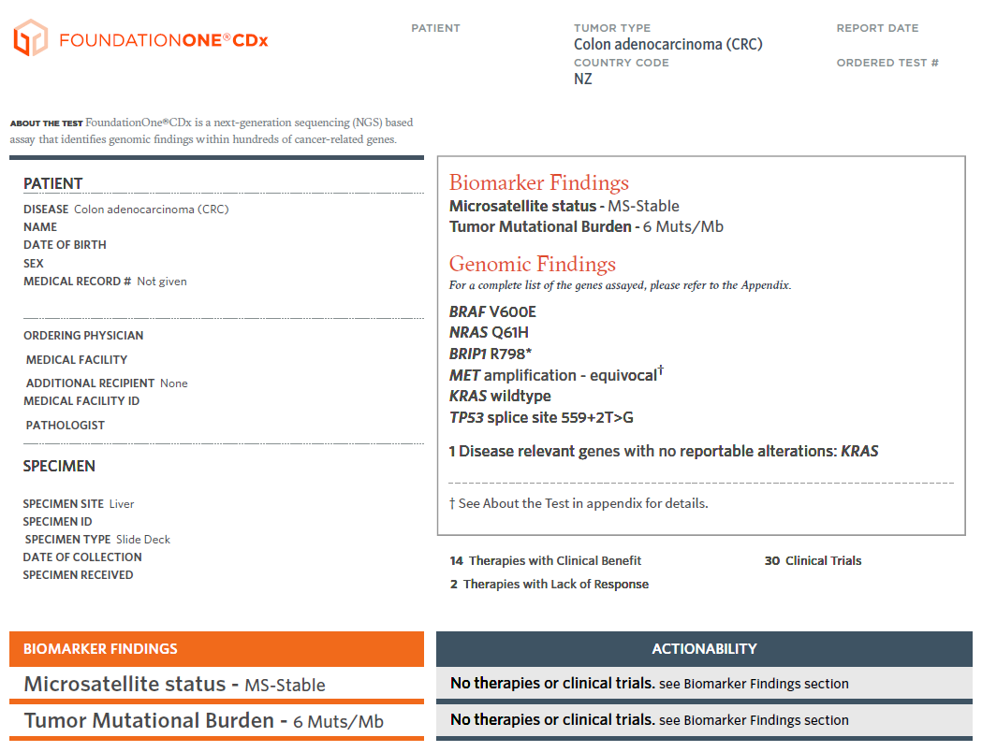
Oncogenes and Tumour Suppressor Genes

Slide 13
Questions?

Slide 14
Hallmarks of Cancer
Hanahan, D. and Weinberg, R.A. 2011. Cell. 144: 646-674

Slide 15
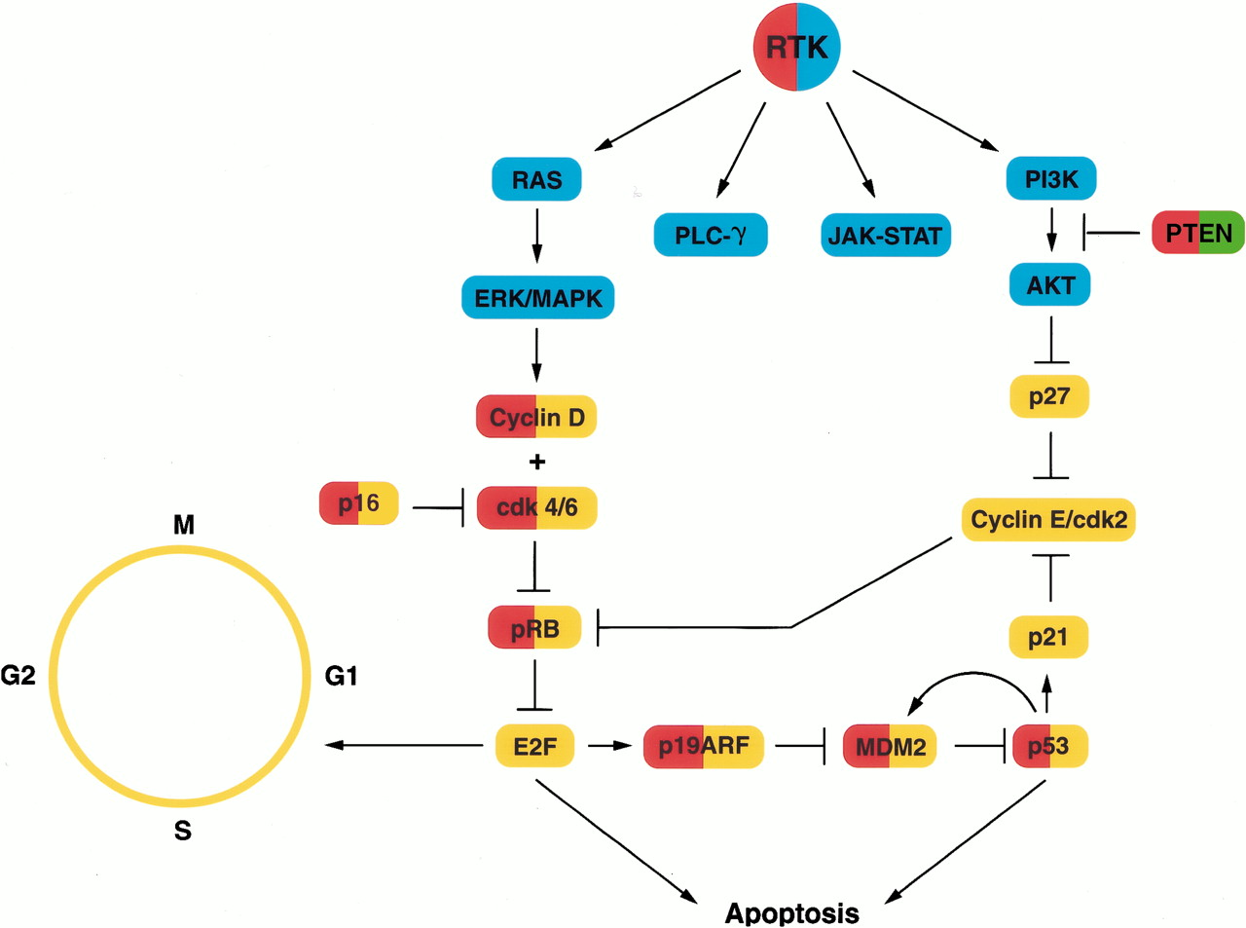
Sustaining Proliferation, Evading Growth Suppressors and Resisting Cell Death
Mechanisms to promote proliferation:
Activation of receptor tyrosine kinase (RTK) pathways
Activation of cell cycle progression regulators
Mechanisms to evade growth suppressors:
Loss of cell cycle inhibitors
Loss of TP53
Apoptosis is a strong barrier to oncogenesis
Circumvented by loss of TP53 and other pro-apoptotic factors, gain of anti-apoptotic factors
Maher, E.A. et.al. 2001. Genes Dev. 15:1311-1333

Slide 16
Sustaining Proliferation, Evading Growth Suppressors and Resisting Cell Death
A RTK cascade is an oncogenic pathway can be activated and targeted at multiple points
Mechanisms of activation
Intervention strategies
Bevacizumab
Cetuximab
Ligand overexpression
Receptor overexpression
Receptor mutation
Regorafinib
GRB-2
SOS
RAS
Mutation of downstream signalling components
Loss of negative regulators of the pathway
BRAF
BRAF
Encorafinib
MEK
Binimetinib
ERK
Cell proliferation

Slide 17
Questions?

Slide 18
Hallmarks of Cancer
Hanahan, D. and Weinberg, R.A. 2011. Cell. 144: 646-674

Slide 19
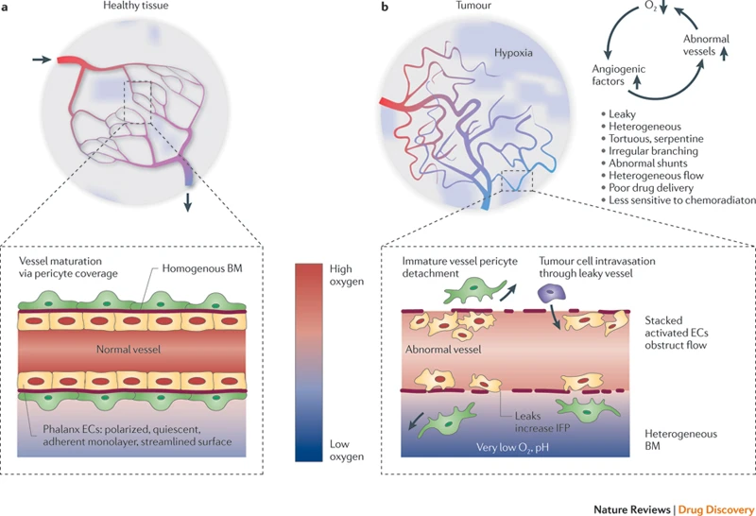
Inducing Angiogenesis
Angiogenesis is essential for tumourigenesis
Vasculature is mostly quiescent in adult tissues but is almost always activated in cancer (“angiogenic switch”)
Tumour vasculature is highly disorganised
VEGF is a potent angiogenic ligand; other ligands include FGFs
Vascular mimicry also occurs in tumours
Carmeliet, P. and Jain, R.K. 2011. Nat. Rev. Drug. Discov. 10: 417-427

Slide 20
Hallmarks of Cancer
Hanahan, D. and Weinberg, R.A. 2011. Cell. 144: 646-674

Slide 21
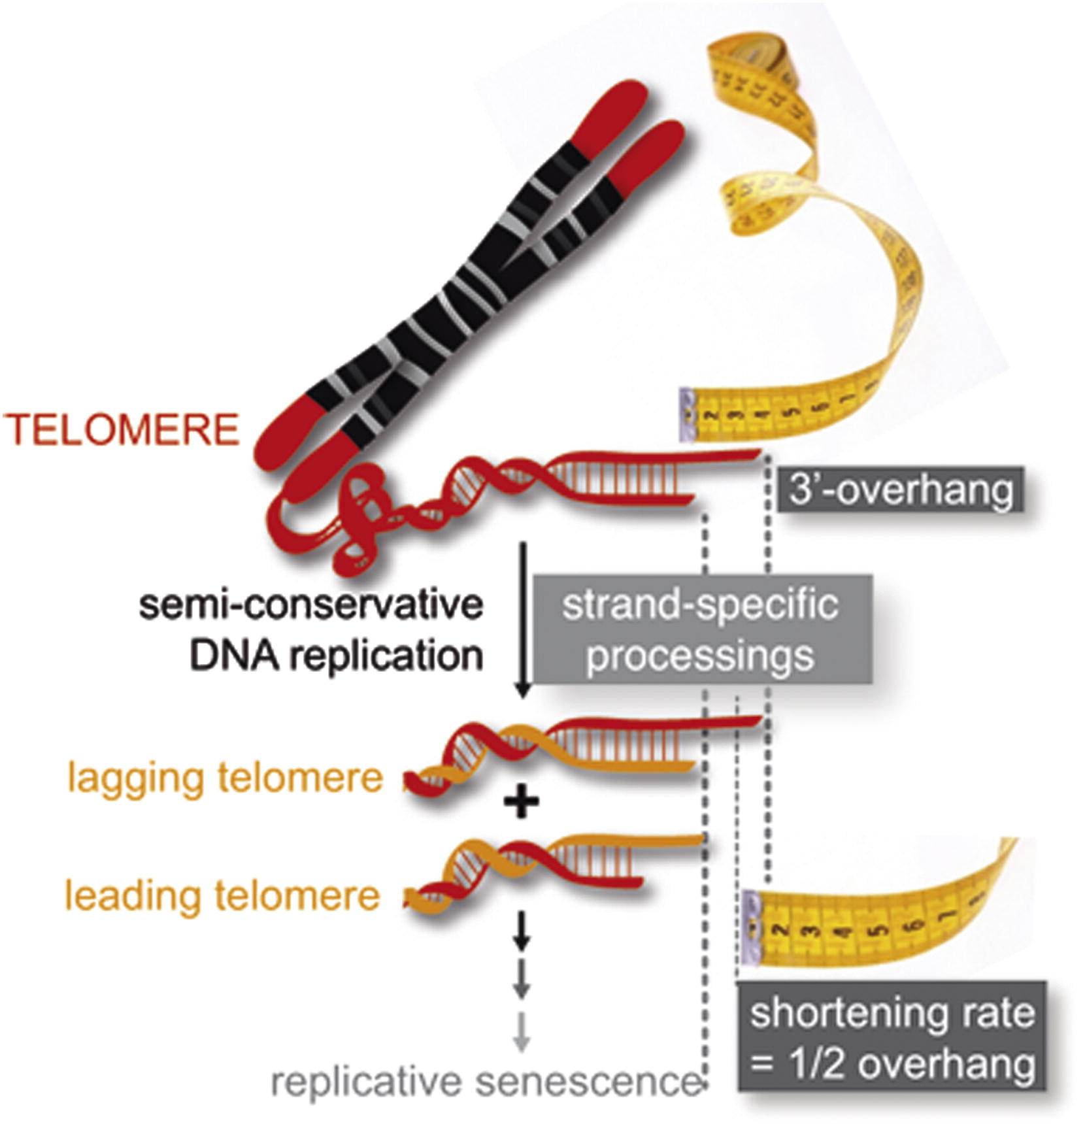
Enabling Replicative Immortality
Telomeres are ends of chromosomes
Maintain chromosome stability
Shorten with each cell division
Tracker of number of cell division
Cancer cells maintain their telomeres by re-expressing telomerase or by alternative lengthening of telomeres
Rai, R. et.al. 2016. Nature Comms. 7: 10881
Soudet, J. et.al. 2014. Mol. Cell. 53: 954-964

Slide 22
Questions?

Slide 23
Hallmarks of Cancer
Hanahan, D. and Weinberg, R.A. 2011. Cell. 144: 646-674

Slide 24
Genomic Instability and Mutation
Normal cells have mechanisms in place to limit the amount of damage in each cell division
Functional telomeres, DNA repair pathways like mismatch repair (e.g. MSH2, MLH1, PMS2), homologous recombination (e.g. BRCA1/2, PALB2, RAD51, BRIP1)
Loss of telomeres, DNA repair pathways proteins removes DNA error correction abilities
Allows the accumulation of mutations in cancer cells
Measured by microsatellite instability, tumour mutational burden (MSI, TMB)

Slide 25
Genomic Instability and Mutation
Microsatellite instability
Microsatellite position (locus)
CACA
CACA
CACA
CACA
CACA
DNA replication with errors
CACA
CACA
CACA
CACA
CACA
CACA
CACA
Mismatch repair intact
Mismatch repair lost
CACA
CACA
CACA
CACA
CACA
CACA
CACA
CACA
CACA
CACA
CACA
CACA
Microsatellite stable
MSS
Proficient Mismatch repair/pMMR
Microsatellite instability
MSI-High
Deficient mismatch repair/dMMR

Slide 26
Genomic Instability and Mutation
Tumour mutation burden (TMB)
Number of somatic mutations per megabase (one million bases) of coding DNA
3’-TAGTTGCATATCGATCTACTCTAGATCGTGGCTAATCTAGAGCTGTTGA……………………………TTGGTACTGTACCTGAGCATG-5’
1 MB of sequence
5’-ATCAACGTATAGCTAGATGAGATCTAGCACCGATTAGATCTCGACAACT……………………………AACCATGACATGGACTCGTAC-3’
TMB: 0 mutations/MB
5’-ATCAACGgATAGCTAGATGAGATCTAGCACCGATTAGATCTCGACAACT……………………………AACCATGACATGGACTCGTAC-3’
TMB: 1 mutation/MB
5’-AaCAACGgATAGCTcGATGAGATCTAGCtCCGATTAGATCTCGAtAACT……………………………AACCATGACATGGACTCGTAC-3’
TMB: 5 mutations/MB
5’-AaCAACGgATAGCTcGATGAaATCgAGCtCCGATTAGtTCTCGAtAACT……………………………AACCAaGACATGaACTCtTAg-3’
TMB: 12 mutations/MB

Slide 27
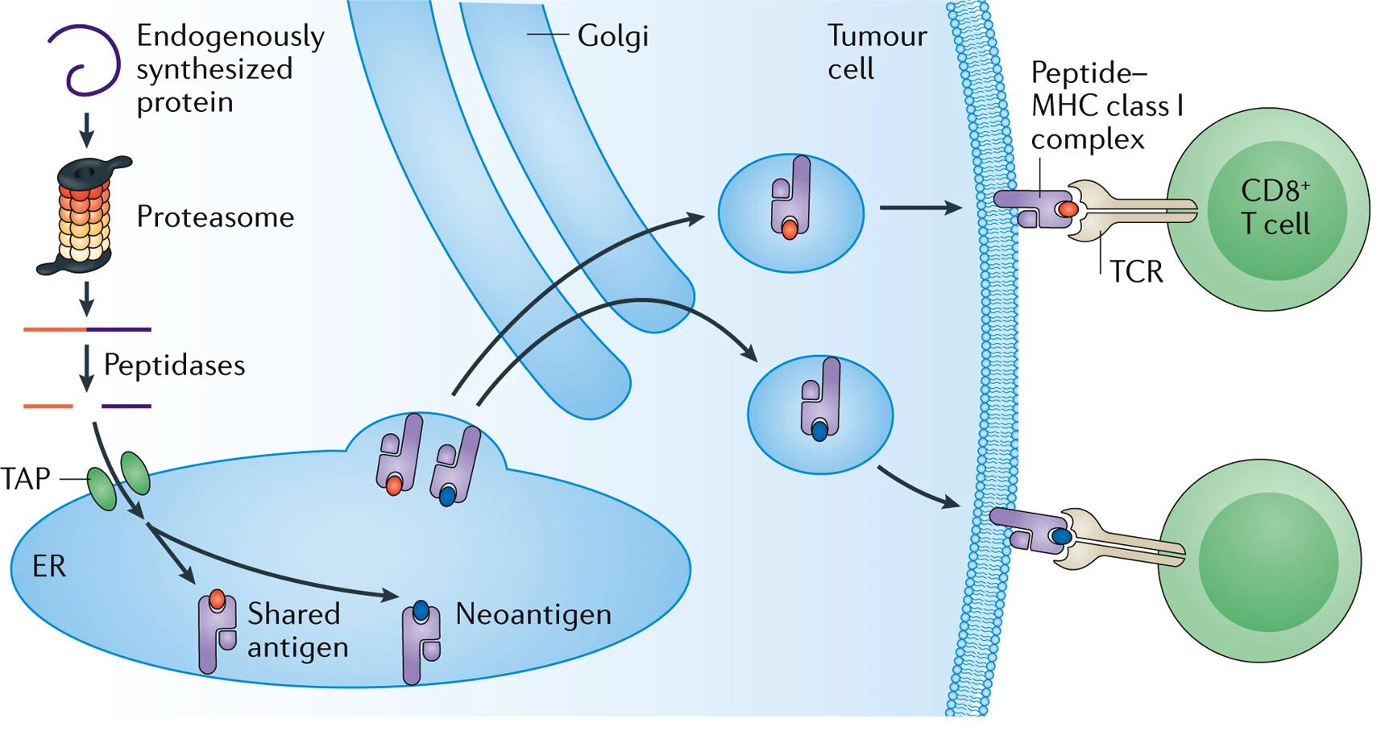
Genomic Instability and Mutation
Mutations provide the background on which tumour evolution works
May also increase the neoantigen load of cancer cells
MMR status (MSS vs MSI/MSI-High) and TMB are used as surrogate markers for neoantigen load
Yarchoan, M. et.al. 2017. Nat. Rev. Cancer. 17: 209-222

Slide 28
Questions?

Slide 29
Hallmarks of Cancer
Hanahan, D. and Weinberg, R.A. 2011. Cell. 144: 646-674

Slide 30
Immune Response in Cancer
Most tumours are infiltrated by immune cells
Cells of the innate immune system – macrophages, natural killer cells
Cells of the adaptive immune system – tumour infiltrating lymphocytes (TILs)
Both immunostimulatory and immunosuppressive
Part of the immune response in tumour promoting – sustains proliferation, limits cell death, modifies the extracellular matrix
Some cancers are intimately linked with infections:
Gastric cancer and Helicobacter pylori
Liver cancer and Hepatitis C
Cervical cancer and Human Papilloma Virus

Slide 31
Immune Response in Cancer
Part of the immune response is attempts at tumour eradication
Responsible for cancer immunoediting
Tumours have variable amounts and pattern of infiltration of CD8+ T cells
Hot
Immune suppressed
Immune excluded
Cold
Galon, J. and Bruni, D. 2019. Nat. Rev. Drug. Discover. 18: 197-218

Slide 32
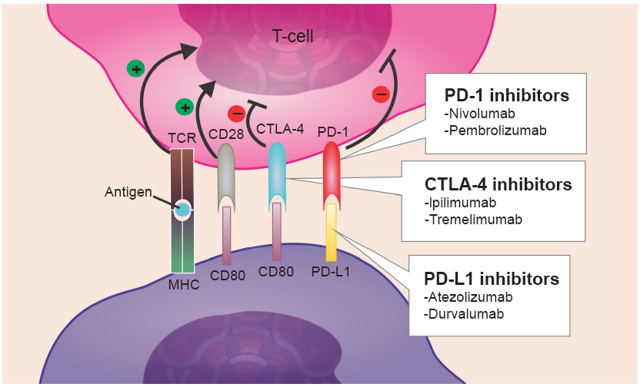
Immune Checkpoints
Strong pathways exist to prevent immune rejection of self and limit immune responses
Immune checkpoints
de Mello R.A. et.al. 2017. Onco Targets Ther. 10:21-30
Cancer cells co-opt these to avoid immune destruction
Tumours with immune checkpoint activation may benefit from by immune checkpoint inhibitors (ICI)

Slide 33
TMB, Immune Infiltration and Immune Checkpoint Inhibitors
Immunologically hot tumours are likely to benefit from ICI
Hot
Immune suppressed
Immune excluded
Cold
Benefit from ICI
Response to ICI modified by other factors:
Tumour microenvironment
Neoantigen load (MMR status, TMB)
Galon, J. and Bruni, D. 2019. Nat. Rev. Drug. Discover. 18: 197-218

Slide 34
TMB, Immune Infiltration and Immune Checkpoint Inhibitors
Prognostic value of TILs may be linked to TMB
Hot
Immune suppressed/ excluded
Cold
Modified from Thomas, A. et. al. 2018. Oncoimmunology. 7: e1490854

Slide 35
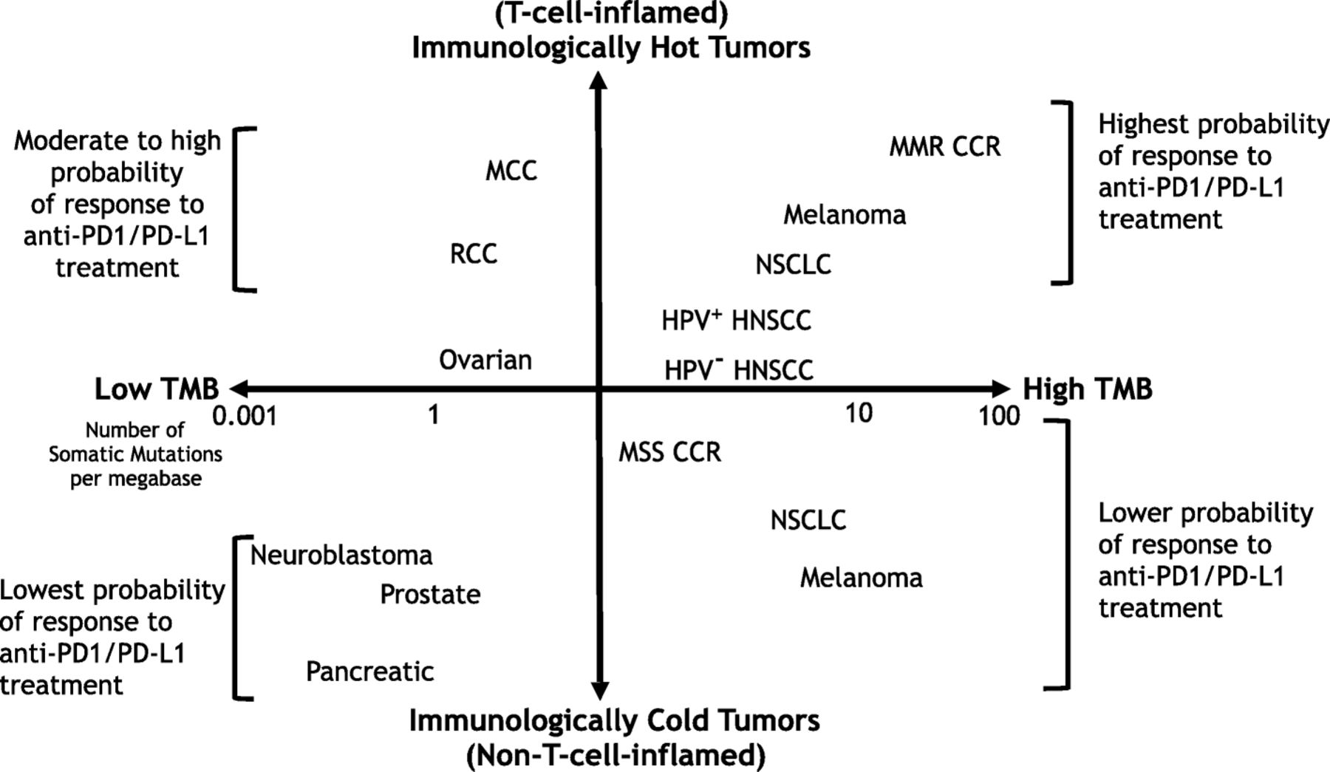
TMB, Immune Infiltration and Immune Checkpoint Inhibitors
d
Maleki Vareki, S. 2018. J Immunother Cancer. 6:157

Slide 36
Questions?

Slide 37
Hallmarks of Cancer
Hanahan, D. and Weinberg, R.A. 2011. Cell. 144: 646-674

Slide 38
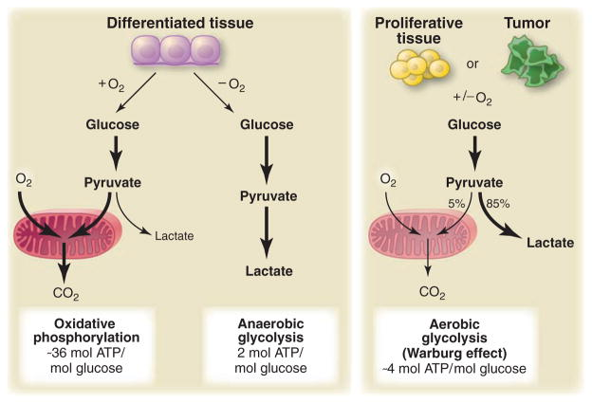
Altered Cellular Metabolism
Many metabolic pathways deregulated in cancer e.g. glutaminolysis, electron transport chain
Glucose metabolism is a key metabolic pathway that is altered in cancer
Cancer cells almost always metabolise glucose poorly even in the presence of oxygen (generate 4 ATP/glucose molecule)
Altered pathways generate metabolic intermediates that are used as substrates by cancer cells
Also impact other cellular processes e.g. DNA methylation, chromatin modification
Vander Heiden, M.G. et.al. 2009. Science. 324: 1029-1033

Slide 39
Questions?

Slide 40
Clonal Heterogeneity and Tumour Evolution
Cancer cells undergo Darwinian selection but are evolving in an expanding population
Genetic drift may play a significant role
Tumours may have relatively low rates of evolution punctuated by periodic jumps (saltatory evolution)
Tumour evolution is often branched and not linear

Slide 41
Clonal Heterogeneity and Tumour Evolution
BRAF^{V600E}, NRAS^{Q61H}
BRAF^{V600E}, BRIP1^{R798*},BRAF^{ΔEx2-10}
BRAF^{V600E}
BRAF^{V600E}, BRIP1^{R798*}
Time
(Modified from Perelman School of Medicine, University of Pennsylvania)

Slide 42
Clonal Heterogeneity and Tumour Evolution
Timing of genomic test and material sampled are important and should be active choices
Therapy applies a strong selective pressure on cells

Slide 43
Questions?

Slide 44
43 yo male
Metastatic CRC
Folfoxiri+
bevacizumab
Encorafenib, binimetinib, cetuximab
Folfoxiri+
bevacizumab
Encorafenib, cetuximab
2021
2019
2020
Colorectal cancer,
liver mets.
Reduction of primary + liver mets
Lesions sig. reduced
Liver lesions increased
Progressing liver +
bone mets
Liver lesion increased
Sampled - tissue
liver mets.
Sampled – blood/plasma
ctDNA
Foundation One CDx tissue
Foundation One
Liquid Cdx
BRAF V600E
BRAF V600E
NRAS Q61H
BRIP1 R798*
MET – amplification
TP53 559+2T>G (splice)
BRAF V600E
BRAF exons 2-10 deletion
BRIP1 R798*
TP53 559+2T>G (splice)

Slide 45
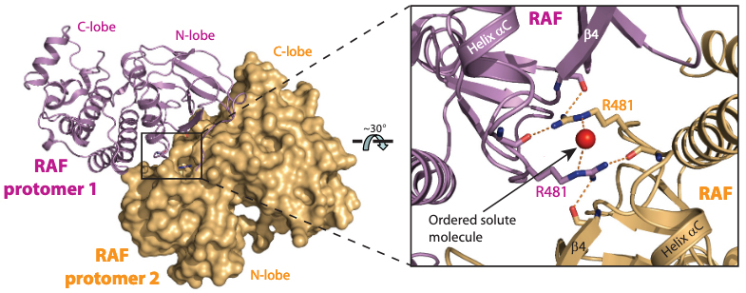
BRAF Dependent Oncogenesis
RTK
R509
GRB-2
SOS
RAS
R509
BRAF
BRAF
pMEK
Modified from Rajakulendran, T. et.al. 2009. Nature. 461: 542-546
pERK
Cell proliferation
BRAF^{WT} must dimerise for signalling; R509 is essential for dimerisation
BRAF^{V600E} common in multiple cancer types, including colorectal cancer

Slide 46
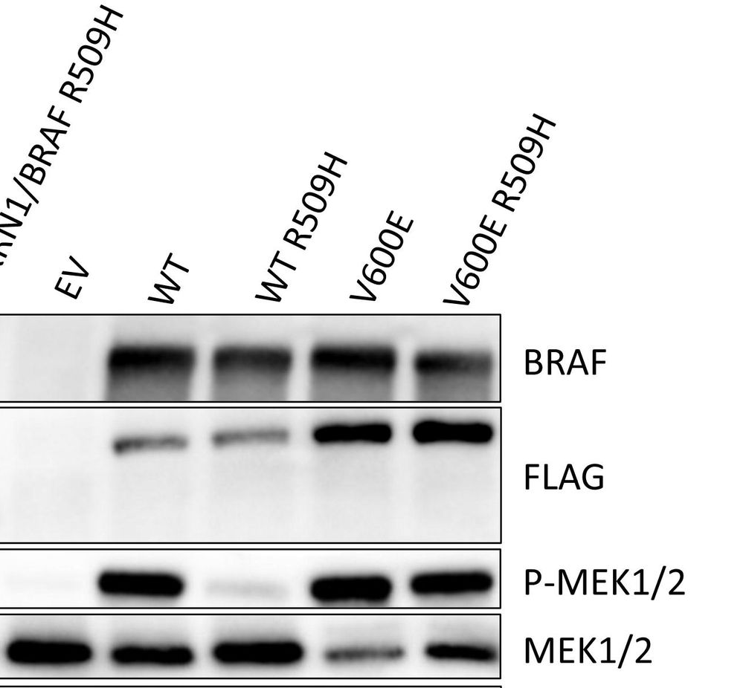
BRAF Dependent Oncogenesis
BRAF^{V600E} Acts as a Monomer
Vemurafenib
pMEK1/2
Girtman, M.A. et.al. 2021. BioRxiv. doi: https://doi.org/10.1101/2021.07.22.453427
Joseph, E.W. et.al. 2010. PNAS. 107: 14903-14908

Slide 47
BRAF Dependent Oncogenesis
BRAF^{WT} - dimer
BRAF^{V600E} - monomer
BRAF^{V600E:ΔInternal Exons} – dimer
RTK
RTK
RTK
GRB-2
SOS
GRB-2
SOS
GRB-2
SOS
RAS
RAS
RAS
BRAF
BRAF
BRAF^{V600E}
BRAF^{V600E:ΔExons}
BRAF^{V600E:ΔExons}
pMEK
pMEK
pMEK
pERK
pERK
pERK
Cell proliferation
Activated by Vemurafenib
Cell proliferation
Sensitive to Vemurafenib
Cell proliferation
Resistant to Vemurafenib

Slide 48
BRAF Dependent Oncogenesis
BRAF^{ΔInternal Exons} are a common mechanism of resistance to BRAF^{V600E} inhibitors
Melanoma patients who progressed on Vemurafenib
CRC patient who progressed on Vemurafenib
Poulikakos, P.I. et.al. 2011. Nature. 480: 388-391.
Tung, J.K. et.al. 2020. Cold Spring Harb Mol Case Stud. 6: a005140

Slide 49
Targeting
angiogenesis
Targeting RTK signalling
Folfoxiri+
bevacizumab
Encorafenib, binimetinib, cetuximab
Encorafenib, cetuximab
2021
2019
2020
Colorectal cancer,
liver mets.
Lesions sig. reduced
Progressing liver +
bone mets
BRAF V600E
BRAF V600E
BRAF exons 2-10 deletion
BRIP1 R798*
TP53 559+2T>G (splice)
Oncogene
Driver mutation
Tumour suppressor genes
DNA repair pathways
Tumour evolution
Acquired resistance

Slide 50
Thank you and feedback welcome!
Anassuya Ramachandran
anassuya.ramachandran@auckland.ac.nz

