Slide 1
Genomics for Cancer Clinicians
Session 3: The utility of genomic testing in cancer care
Genomics into
Medicine
Dr Sandra Fitzgerald

Slide 2
Acknowledgements
This course is the work of a large team:
Cris Print
Ben Lawrence
Polona Le Quesne Stabej
Sandra Fitzgerald
Alex Henderson
Ana Ramachandran
Tamsin Robb
Thierry Lints
Kimi Henare
Vicky Fan
Alice Minhinnick
Sylvie Chan
Nadia Hitchen
Angela Mweempwa
Sanjeev Deva
James Opie

Slide 3
Session 3: The utility of genomic testing in cancer care
Introduction: Case overview
Selection of tissue for genomics: Use of formalin fixed paraffin embedded (FFPE) tissue Use of blood plasma Outline of genomic tests available
Large Scale Genomic tests: What does a VAF tell us How does a plasma test vary from a tumour tissue genomic analysis What do the test results mean: Can the identification of a variant lead to a treatment option?
Pros and Cons of the different tests Which test should be chosen

Slide 4
Current Clinical Scenario
Male, 41 years presented to the clinic in 2018 with a four week history of left iliac fossa pain.
Diagnosed as colorectal cancer with multiple liver metastasis
Nov 2018 – commenced treatment

Slide 5
Folfoxiri+
bevacizumab
Encorafenib, binemetinib, cetuximab
Folfoxiri+
bevacizumab
Encorafenib, cetuximab
2019
2020
2021
Colorectal cancer,
liver mets.
Reduction of primary+
liver mets
Lesions sig. reduced
Liver lesions increased
Progressing liver mets and
- bone mets
Liver lesion increased
Foundation One CDx tissue
Foundation One CDx Liquid
Biopsy - histology
BRAF V600E

Slide 6
Session 3: The utility of genomic testing in cancer care
Introduction: Case overview
Selection of tissue for genomics: Use of formalin fixed paraffin embedded (FFPE) tissue Use of blood plasma Outline of genomic tests available
Large Scale Genomic tests: What does a VAF tell us How does a plasma test vary from a tumour tissue genomic analysis What do the test results mean: Can the identification of a variant lead to a treatment option?
Pros and Cons of the different tests Which test should be chosen

Slide 7
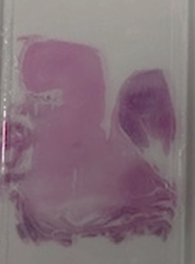
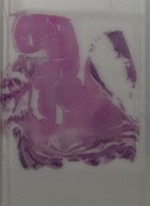
Tumour tissue for genomic testing
Surgical specimen, biopsy or FNA is collected and fixed in formalin and parrafin embedded (FFPE)
Thin slides are cut and mounted on glass slides
A pathologist will review a H&E slide, and regions of tumour are scraped, DNA/RNA extracted
Normally yields good quality DNA/RNA

Slide 8
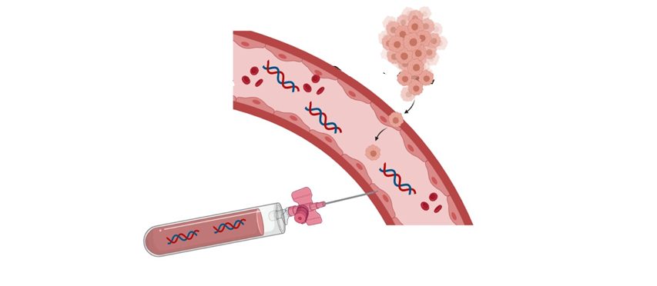
Blood sample for genomic testing
Blood sample contains cell-free DNA (cfDNA) and circulating tumour DNA (ctDNA)
cfDNA - endothelial/leucocytes
ctDNA - from necrosing/apoptosing tumour cells
The cfDNA/ctDNA extracted for genomic analysis – low concentration and fragmented
The cfDNA/ctDNA extracted for genomic analysis – low concentration and fragmented

Slide 9
What genomic analyses can we perform?
Small scale – single gene tests
Medium scale - "hot spot" testing
Large scale genomic testing

Slide 10
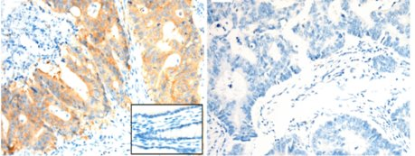
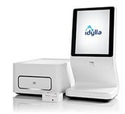
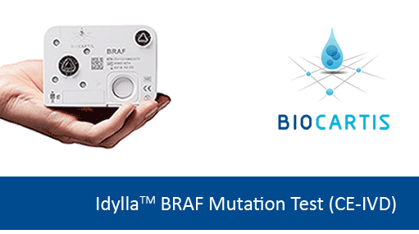
What genomic analyses can we perform?
BRAF V600E IHC positive
BRAF WT IHC
Small scale: single gene testing
Clinically validated qPCR tests (eg Idylla and cobas)
Detects multiple different variants at V600 locus
Idylla run at LabPlus for tumour tissue

Slide 11
What genomic analyses can we perform?
Medium scale analysis:
MassArray hotspot mutation testing – detects ~200 variants in 5 genes (BRAF, NRAS, KRAS, EGFR, KIT)
Clinically validated and run at LabPlus/GCG for tumour tissue analysis

Slide 12
AmpliSeq for Illumina
AmpliSeq for Illumina: Tumour only
Clinically validated at Wellington Regional Genetics
50 genes - DNA mutations:

Slide 13
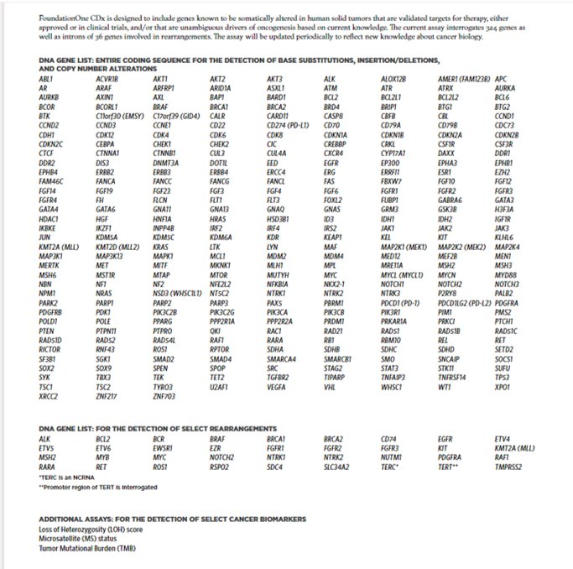
Larger Scale Genomic Analysis: FoundationOne CDx and Liquid CDx
​
Tumour tissue or blood plasma
FDA approved – processed in USA
​
324 genes - DNA mutations:
Selected rearrangements:

Slide 14
Larger scale genomic analyses: TSO500
TSO500: Tumour analysis only
Currently in validation GCG
523 genes: DNA mutations and amplifications
55 genes: RNA fusions and splice variants

Slide 15
Session 3: The utility of genomic testing in cancer care
Introduction: Case overview
Selection of tissue for genomics: Use of formalin fixed paraffin embedded (FFPE) tissue Use of blood plasma Outline of genomic tests available
Large Scale Genomic tests: What does a VAF tell us How does a plasma test vary from a tumour tissue genomic analysis What do the test results mean: Can the identification of a variant lead to a treatment option?
Pros and Cons of the different tests Which test should be chosen

Slide 16
What does the NGS data look like for tumour tissues?
Example of data a clinician may receive – mutation identified and the relative frequency of this mutation
How is NGS data visualised and what does a VAF mean?

Slide 17
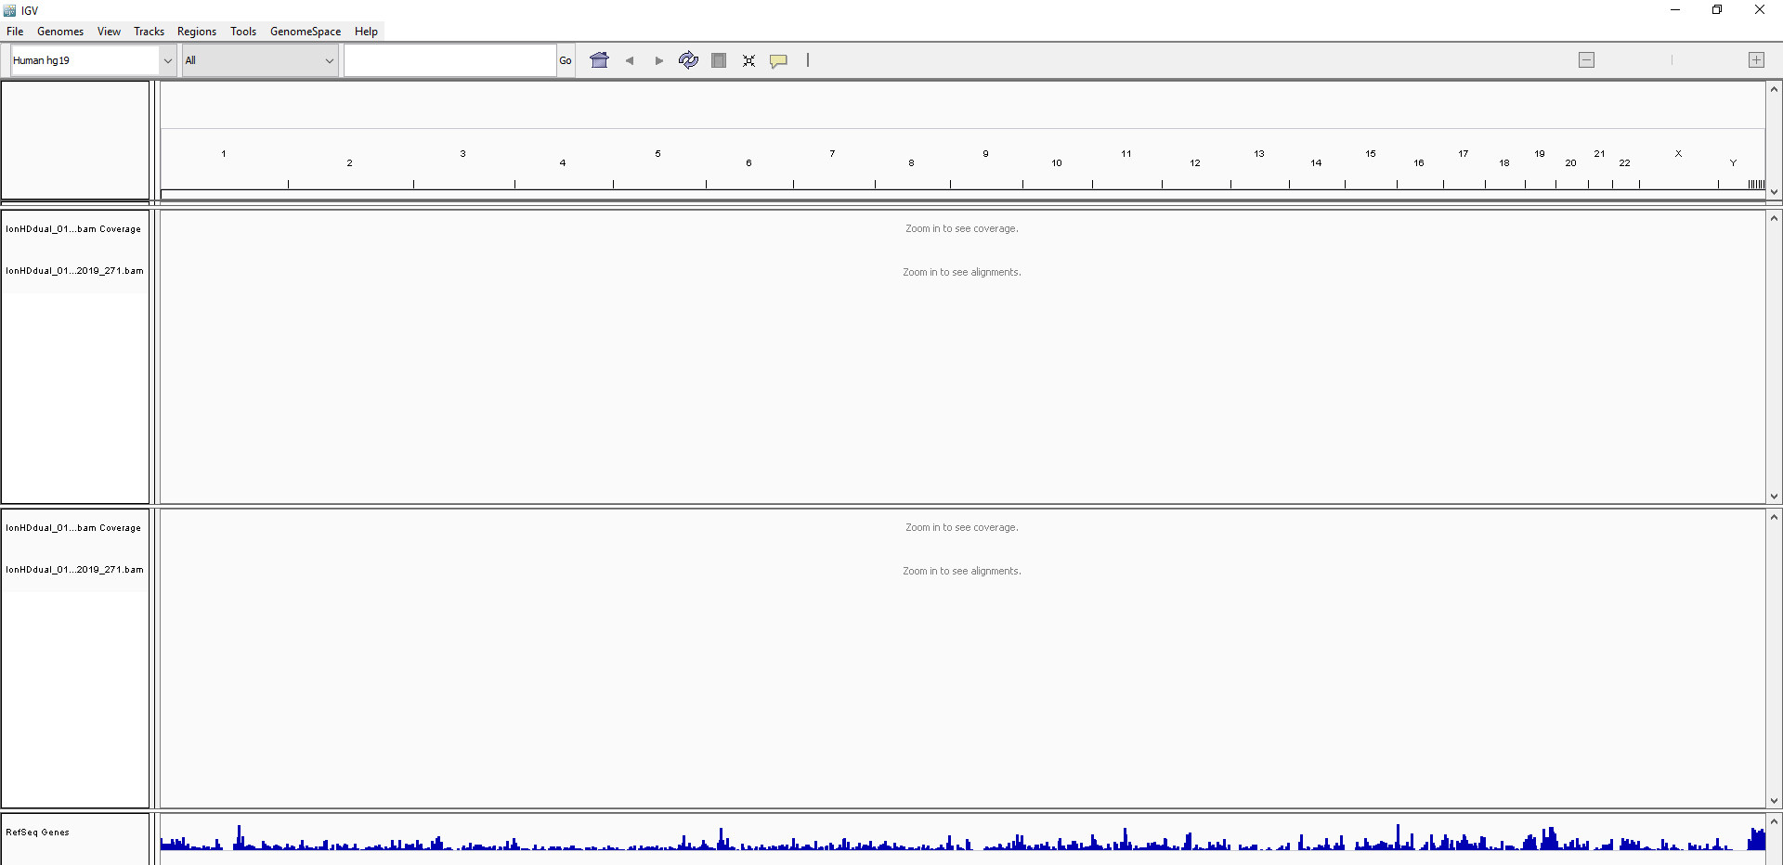
Integrated Genome Viewer for visualising NGS data
All chromosomes
Patient sample 1
We need to zoom in to see individual sequences
Patient sample 2
All genes in human reference genome

Slide 18
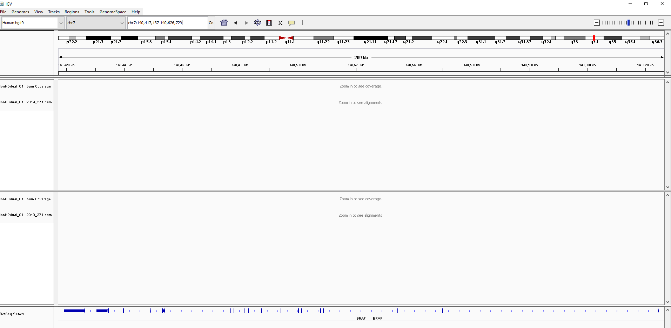
IGV – zoomed into BRAF gene – chromosome 7
Zoomed in to BRAF gene

Slide 19
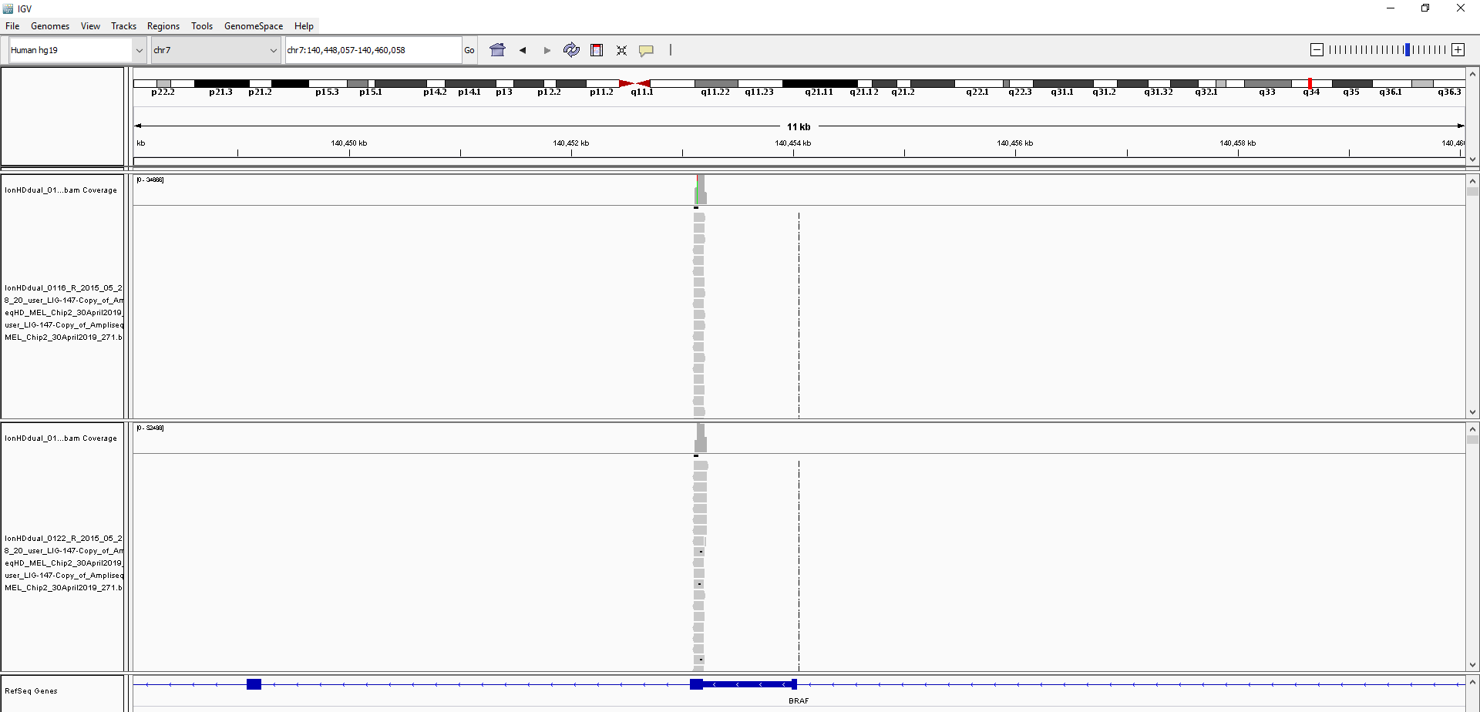
IGV – zoomed into exon 15 of BRAF gene
NGS reads patient 1
NGS reads patient 2
Zoomed into exon 15 BRAF – V600E locus

Slide 20
IGV – BRAF mutation identified in tumour tissue
Read Depth – RD (coverage)
Number of independent reads at a variant of interest
Reference allele (WT)
Alternative allele – or somatic mutation
Gene and the reference allele
Variant Allele Frequency (VAF) expect for tumour tissue ~50% (here is 42%)

Slide 21
Tumour VAF what does it tell us?
The VAF identified in tumour tissue NGS can vary :
Mutation VAF relatively low – 18%
Patient 1 tumour sequencing

Slide 22
Tumour VAF what does it tell us?
The VAF identified in tumour tissue NGS can vary :
From relatively low – 18%
Patient 1 tumour sequencing
Up to and over 50%
WHY can we see these differences?
Normal cells contamination
Aneuploidy (losses and gains of chromosomes) in the tumour tissue can affect the VAF
Patient 2 tumour sequencing

Slide 23
What does the NGS from plasma cfDNA look like?

Slide 24
What does the NGS from plasma cfDNA look like?
Read Depth – RD (coverage) >10,000
WT allele is very high (97%)
Variant allele is a low (3%)
Variant Allele Frequency – VAF is 3%​
% of sequence reads observed matching a specific DNA variant

Slide 25
ctDNA VAF what does it tell us?
The VAF identified in ctDNA NGS can also vary and reflects the amount of circulating tumour present in the plasma:
Often the VAF is very low for ctDNA <1%​
(actually 0.35% here)​
​
Patient 1 cfDNA sequencing

Slide 26
ctDNA VAF what does it tell us?
The VAF identified in ctDNA NGS can also vary and reflects the amount of circulating tumour present in the plasma:
Often the VAF is very low for ctDNA <1%​
(actually 0.35% here)​
​
Patient 1 cfDNA sequencing
​
A higher VAF reflects a higher burden of disease – in this case VAF of 8%
Patient 2 cfDNA sequencing

Slide 27
Folfoxiri+
bevacizumab
Encorafenib, binemetinib, cetuximab
Folfoxiri+
bevacizumab
Encorafenib, cetuximab
2019
2020
2021
Colorectal cancer,
liver mets.
Reduction of primary+
liver mets
Lesions sig. reduced
Liver lesions increased
Progressing liver mets and
- bone mets
Liver lesion increased
Foundation One CDx tissue
BRAF V600E
NRAS Q61H
BRIP1 R798*
MET - amplification
TP53 559+2T>G (splice)
Foundation One CDx Liquid
BRAF V600E
BRAF exons 2-10 deletion
BRIP1 R798*
TP53 559+2T>G (splice)
BRAF V600E

Slide 28
What did the tumour genomic tests tell us?
Mutations identified in the tumour genomic analysis
KRAS WT confirmed

Slide 29
What did the tumour genomic tests tell us?
Previously treated
Possibly resistant to these treatments

Slide 30
What do the biomarkers from the tumour tissue tell us?
Low TMB <10 Muts/Mb
MS-Stable
TMB and MSI measure the number of mutations presents in the samples – there are implications for therapies especially immunotherapy

Slide 31
Folfoxiri+
bevacizumab
Encorafenib, binemetinib, cetuximab
Folfoxiri+
bevacizumab
Encorafenib, cetuximab
2019
2020
2021
Colorectal cancer,
liver mets.
Reduction of primary+
liver mets
Lesions sig. reduced
Liver lesions increased
Progressing liver mets and
- bone mets
Liver lesion increased
Foundation One CDx tissue
BRAF V600E
NRAS Q61H
BRIP1 R798*
MET - amplification
TP53 559+2T>G (splice)
Foundation One CDx Liquid
BRAF V600E
BRAF exons 2-10 deletion
BRIP1 R798*
TP53 559+2T>G (splice)
BRAF V600E

Slide 32
What did the liquid genomic tests tell us?
Mutations identified in the BLOOD genomic analysis
BRAF deletion likely confers resistance to these drugs

Slide 33
So: what are the difference in the results from the two tests?
Variant | p.V600E | Exon 2-10 deletion
Time tissue/blood taken | Tissue -January 2020 Blood (ctDNA) – October 2020 | NOT present in tissue Jan 2020 Blood (ctDNA) – October 2020
Genomic location (GRCh37) | Chr7:g.140453136A>C | Intron 1- Intron 10
Variant type | Substitution | Deletion of 9 exons
Translational impact | Missense change | Truncated protein
Gene Function | Oncogene | Oncogene
Variant Allele Frequency (VAF) | Not available in tissue test; 16.7% in ctDNA test | 11.7%
Read depth | Not available | Not available
Exon 2-10 deletion drives acquired resistance to BRAF inhibitors

Slide 34
Session 3: The utility of genomic testing in cancer care
Introduction: Case overview
Selection of tissue for genomics: Use of formalin fixed paraffin embedded (FFPE) tissue Use of blood plasma Outline of genomic tests available
Large Scale Genomic tests: What does a VAF tell us How does a plasma test vary from a tumour tissue genomic analysis What do the test results mean: Can the identification of a variant lead to a treatment option?
Pros and Cons of the different tests Which test should be chosen

Slide 35
Pros and cons of tumour and plasma genomic testing?
Tumour genomic testing
Plasma genomic testing
Tumour tissue required
Ease of sampling/re-testing
Cost of the test
Offshore providers?
tumour heterogeneity/evolution
Tumour heterogeneity
Issues with sensitivity
Difficult to re-test
CHIP
Indicated drugs or clinical trials might not be available/funded

