Slide 1
Genomics for Cancer Clinicians
6-session practical course
Genomics into
Medicine

Slide 2
Acknowledgements
This course is the work of a large team:
Cris Print
Ben Lawrence
Polona Le Quesne Stabej
Sandra Fitzgerald
Alex Henderson
Ana Ramachandran
Tamsin Robb
Thierry Lints
Kimi Henare
Vicky Fan
Alice Minhinnick
Sylvie Chan
Nadia Hitchen
Angela Mweempwa
Sanjeev Deva
James Opie

Slide 3
Schedule
Session 1 | Essential genetics and genomics for clinical practice Dr Polona Le Quesne Stabej, University of Auckland | 2pm, May 27th 2022
Session 2 | Practical variant interpretation Dr Polona Le Quesne Stabej, University of Auckland | 2pm, June 3rd 2022
Session 3 | Using next generation genomic tests Dr Sandra Fitzgerald, University of Auckland | 2pm, June 10th 2022
Session 4 | Cancer biology matters for precision oncology Dr Ana Ramachandran, University of Auckland | TBC
Session 5 | Inherited Cancer Predisposition Dr Alex Henderson, Auckland District Health Board | TBC
Session 6 | Interactive session | TBC

Slide 4
Practical variant interpretation Dr. Polona Le Quesne Stabej
Session 2:

Slide 5
Session 2: Practical variant interpretation | Time
Recap session 1
Why genomic variant interpretation matters
Variant interpretation standards in cancer
Interactive variant interpretation: Case 1

Slide 6
Cancer and Genomic Testing
43 y old, male
Metastatic CRC
2019
2021
2020
Colorectal cancer,
liver mets.
Sampled - tissue
liver mets.
Sampled – blood/plasma
ctDNA
Foundation One CDx tissue
Foundation One
Liquid Cdx
Histo:
moderately differentiated adenocarcinoma,
pMMR, BRAF mutation
BRAF V600E
NRAS Q61H
BRIP1 R798*
MET – amplification
TP53 559+2T>G (splice)
BRAF V600E
BRAF exons 2-10 deletion
BRIP1 R798*
TP53 559+2T>G (splice)

Slide 7
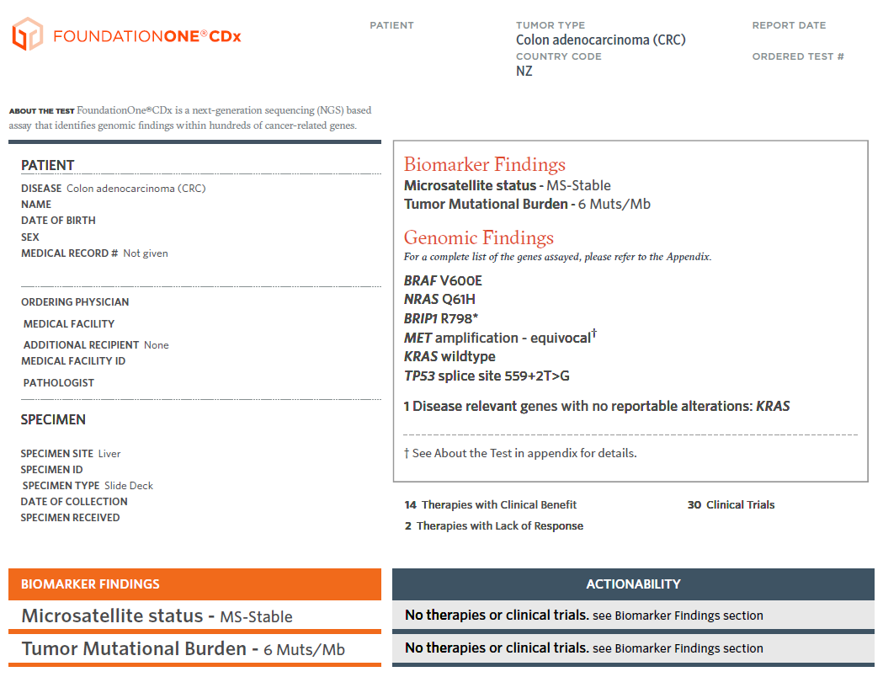
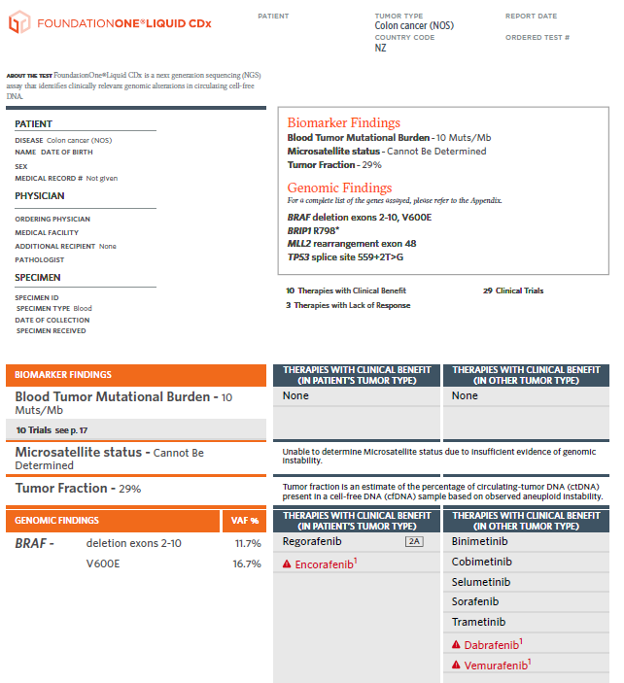
Cancer and Genomic Testing
43 y old, male
Metastatic CRC

Slide 8
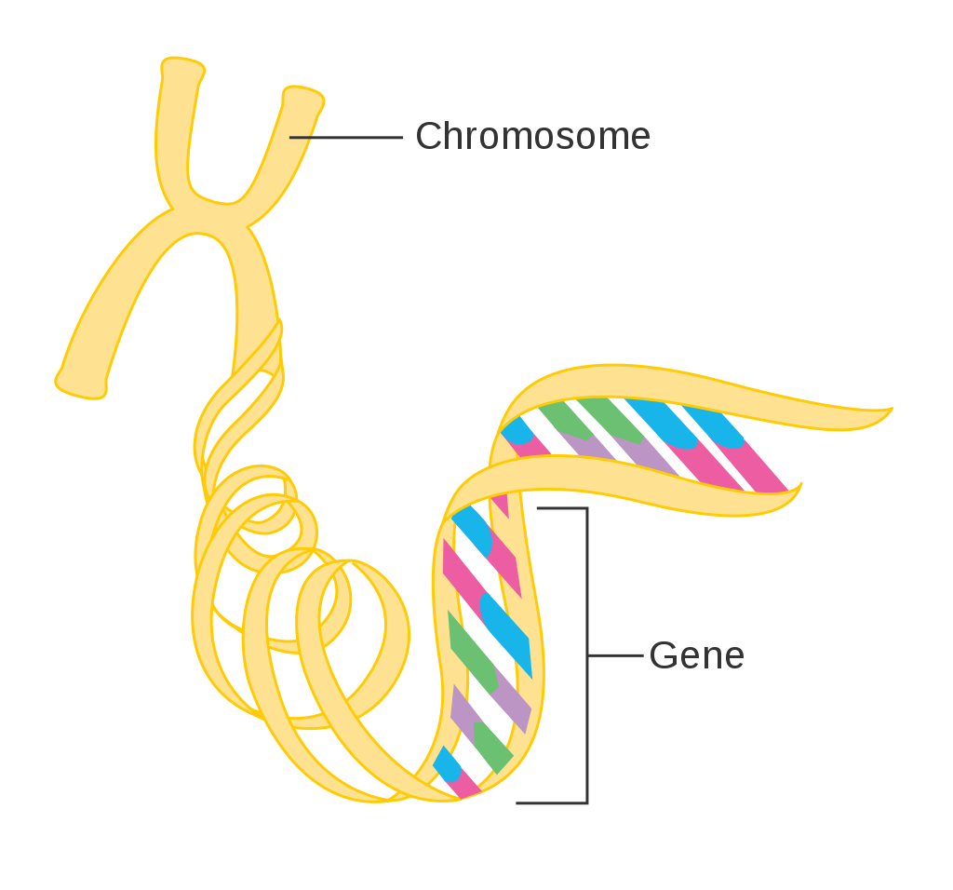
The genome
23 chromosome pairs
̴ 3.12x10⁹ base pairs A-T, C-G
A
A
C
C
T
T
G
G
̴ 21,000 protein coding genes
Mitochondrial DNA
From: CRUK Cancer Research UK, CC BY-SA 4.0
Genome: all the genes and non-coding DNA between genes
Exome (coding parts of 21,000 genes): 1-2% of the genome
Notes:
Chromosome picture from: https://commons.wikimedia.org/wiki/File:Diagram_of_a_gene_on_a_chromosome_CRUK_020.svg / If re-used, attribute to Cancer Research UK / Wikimedia Commons / By Cancer Research UK - Original email from CRUK, CC BY-SA 4.0, https://commons.wikimedia.org/w/index.php?curid=34332671

Slide 9
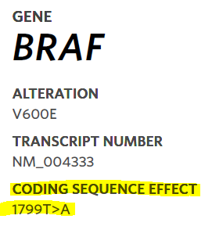
Chr7:g.140,453,136A>T
genomic pos140453136A>T
on chr 7, A replaced with T
Chromosome 7
BRAF genomic DNA
Exon 14
Intron 14
….TTT CTC TGT
Intron 15
Exon 16
Exon 17
….TTT CAC TGT
NM_004333.5:c.1799T>A
Coding DNA position 1799 in gene, T replaced with A
Transcription & Splicing
c.1799T>A
Coding DNA (mRNA)
5’UTR
ATG
….ACA GAG AAA
TAA
………..
….ACA GTG AAA
3’UTR
Translation
?
M
Protein
E
Stop
V
p.V600E (p.Val600Glu)
Valine in position 600 of protein replaced with Glutamic acid
p.V600E

Slide 10
https://www.yourgenome.org/video/from-dna-to-protein

Slide 11
Variants contributing to tumors
Oncogenes
Tumour suppressor genes
Cancer-promoting
Cancer Inhibiting
Chromosome 7
Chromosome 17
BRCA1
Aneuploidy
Loss of Heterozygosity
BRAF p.V600E
BRAF (normal/ wild type)
BRCA1 p.Gln563Ter
?
A variant in BOTH copies of a tumour suppressor gene can lead to cancer
Turns on an accelerator for tumour growth

Slide 12
Sequence Variant Nomenclature: HGVS
Gene
Transcript
Coding DNA
Protein
BRAF NM_00433.5: c.1799T>A p.(Val600Glu) or p.(V600E)
http://varnomen.hgvs.org/

Slide 13
Session 2: Practical variant interpretation | Time
Recap session 1
Why genomic variant interpretation matters
Variant interpretation standards in cancer
Interactive variant interpretation: Case 1

Slide 14
Role of Variant Interpretation / Curation
E
Molecular Tumour Board?
Chromosome 7
Chromosome 7
Classification
of
evidence
BRAF p.V600E
BRAF p.V600E
Oncogenicity assessment
Efficacy?
Therapeutic &Prognostic & Diagnostic

Slide 15
Session 2: Practical variant interpretation | Time
Recap session 1
Why genomic variant interpretation matters
Variant interpretation standards in cancer
Interactive variant interpretation: Case 1

Slide 16
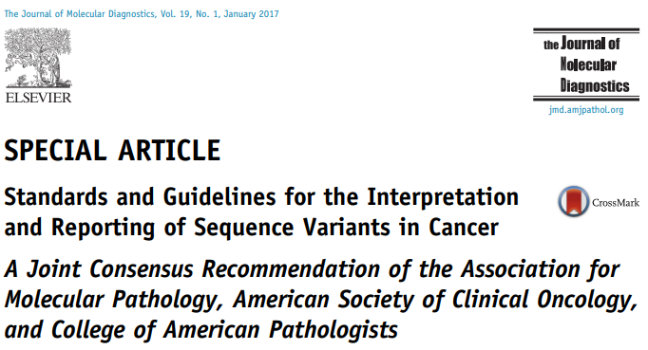
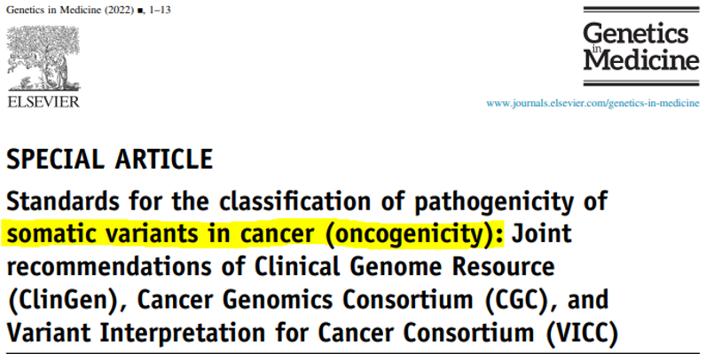
Standards
Horak P, et al. doi: 10.1016/j.gim.2022.01.001. Epub ahead of print. PMID: 35101336.
Benign-Likely Benign-VUS-Likely Oncogenic-Oncogenic

Slide 17
Standards
Automated
Manual
Manual curation
Horak et al., Genes Chromosomes Cancer, 2021
Horak et al., Genet Med., 2022

Slide 18
Limitations of the test
(Session 3)
Genes sequenced:
324: entire coding sequence (substitutions, small indels)
35: introns as well (rearrangements)
Genes sequenced?
(p.25)
Loss of Heterozygosity:
Only verified for ovarian cancer
DNA & RNA?
?
From: Horak et al., Genet Med., 2022

Slide 19
Databases
Variant effect
c.
p.
HGVS nomenclature
General pop.
gnomAD
>150k
Eliminate technical artefacts
Eliminate common variants
From: Horak et al., Genet Med., 2022

Slide 20
Functional &
biological
impact
Somatic databases
Benign
Likely Benign
COSMIC
Effect on gene function?
Literature
Effect on protein function?
Variant of
Uncertain
Significance
in vitro
in vivo
Role in mol. signaling?
Likely Oncogenic
in silico
?
Oncogenic
From: Horak et al., Genet Med., 2022

Slide 21
Evaluate clinical evidence
Clinical data
Levels of evidence
Contradictory evidence?
Same entity
Tier I
A
B
Literature
Preclinical data
Quality of published data
Different entity
Tier II
C
D
Small cohorts/
case reports
Reports
?
Tier III
Unknown

Slide 22
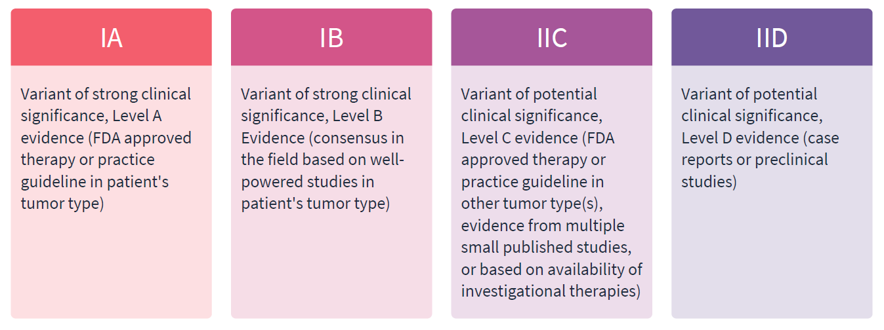

Slide 23
Session 2: Practical variant interpretation | Time
Recap session 1
Why genomic variant interpretation matters
Variant interpretation standards in cancer
Interactive variant interpretation: Case 1

Slide 24
Male, 43 years
Colorectal Cancer
Gene variant BRAF p.(V600E)
Assay method | Foundation One (F1)CDx & Liquid Cdx [SESSION 3]
Gene Function | Oncogene (OnkoKB)
Variant type | Missense variant
Genomic location (GRCh37) | Chr7:g.140453136A>T or NC_000007.13:g.140453136A>T
Transcript variant | NM_004333.5:c.1799T>A
Protein variant | p.(Val600Glu) / p.(V600E)
Frequency in general population | gnomAD 1/251,260
Variant Allele Frequency (VAF) [SESSION 3] | Not available in F1CdX; 16.7% in F1Liquid Cdx
Read depth [SESSION 3] | Not available

Slide 25
Gene variant BRAF p.(V600E)
General Population | GnomAD | ✓ gnomAD 1/251,260 / very rare
Cancer Databases (somatic variants) | Cancer Hotspot | ✓ 113x bowel cancer samples
 | ONCOKb | ✓ Oncogenic in CRC
 | cBioPortal | ✓ 48/595 (~8%) CRC adenocarcinoma samples
Disease Databases | ClinVar | ✓Yes, pathogenic somatic
In silico |  | Support V600E is oncogenic
In vitro/in vivo |  | SESSION 4 (Ana) Gain of function in an oncogene
Somatic/Germline? |  | Somatic
Oncogenicity

Slide 26
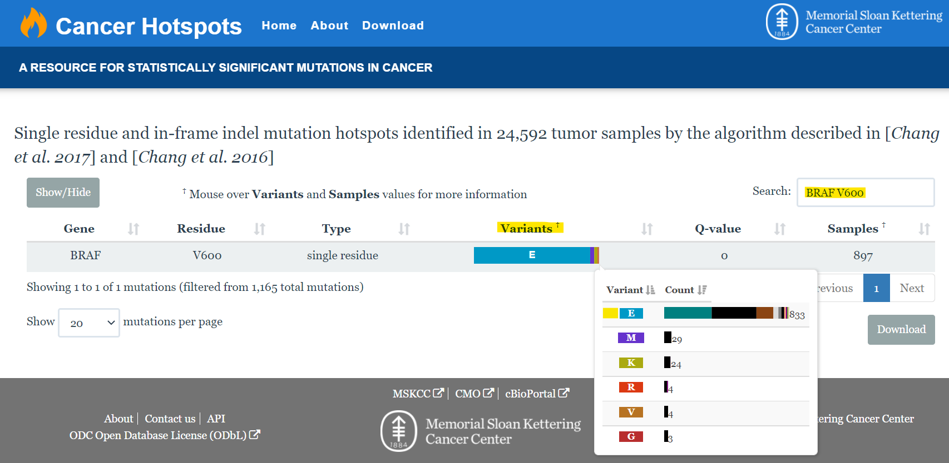
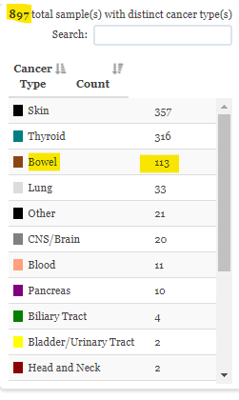
Notes:
Two examples of cancer databases containing information on somatic variants/changes found in various cancers:
OnkoKB: https://www.oncokb.org/
Cancer Hotspots: http://www.cancerhotspots.org/

Slide 27
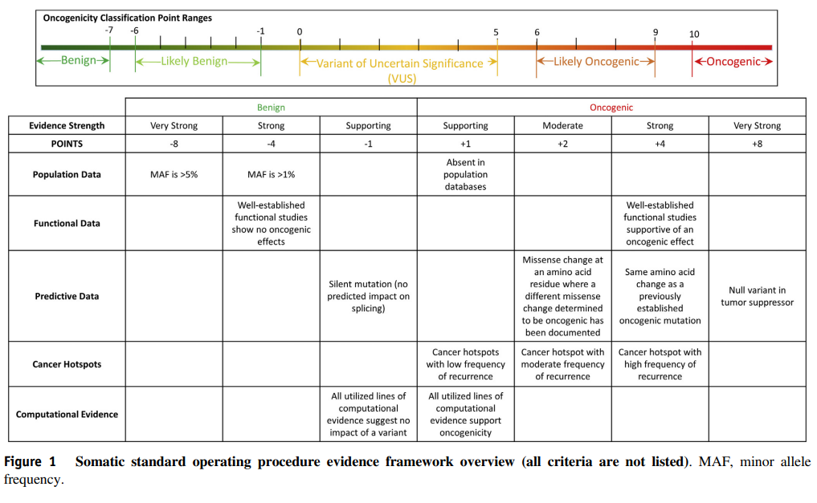
From: Horak et al., Genet Med., 2022

Slide 28
Gene variant BRAF p.(V600E)
General Population | GnomAD | ✓ gnomAD 1/251,260 / very rare
Cancer Databases (somatic variants) | Cancer Hotspot | ✓ 113x bowel cancer samples
 | ONCOKb | ✓ Oncogenic in CRC
 | cBioPortal | ✓ 48/595 (~8%) CRC adenocarcinoma samples
Disease Databases | ClinVar | ✓Yes, pathogenic somatic
In silico |  | Support V600E is oncogenic
In vitro/in vivo |  | SESSION 4 (Ana) Gain of function in an oncogene
Somatic/Germline? |  | Somatic
Oncogenicity |  | Oncogenic

Slide 29
Gene variant BRAF p.(V600E)
Cancer Databases (somatic variants) | CiViC | Level A: Encorafenib + Catuximab
 | ONCOKb | FDA approved: Encorafenib + Catuximab
Publications | BEACON study (Kopetz et al, 2019; Tabernero et al 2021; Journal of Clinical Oncology 2021 39:4, 273-284) encorafenib plus cetuximab | BEACON study (Tabernero et al 2021; Journal of Clinical Oncology 2021 39:4, 273-284)
Somatic/Germline? |  | Somatic
Clinical significance

Slide 30
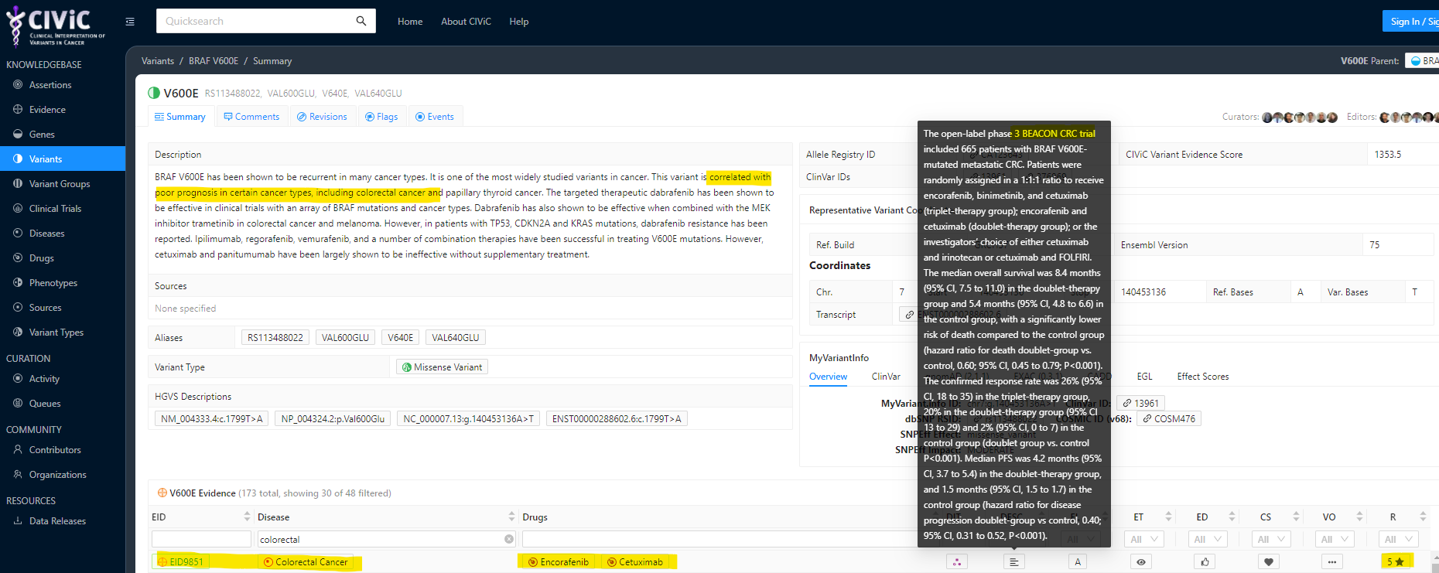
https://civicdb.org/variants/12/summary

Slide 31
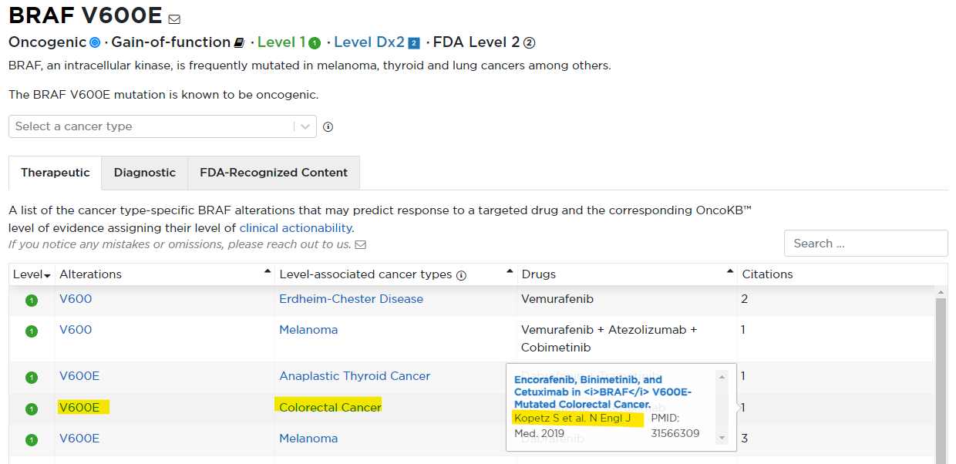

Slide 32
Gene variant BRAF p.(V600E)
Cancer Databases (somatic variants) | CiViC | Level A: Encorafenib + Catuximab
 | ONCOKb | FDA approved: Encorafenib + Catuximab
Publications | BEACON study (Kopetz et al, 2019; Tabernero et al 2021; Journal of Clinical Oncology 2021 39:4, 273-284) encorafenib plus cetuximab | BEACON study (Tabernero et al 2021; Journal of Clinical Oncology 2021 39:4, 273-284)
Somatic/Germline? |  | Somatic
Clinical significance |  | Tier IA

Slide 33
Male, 43 years
Colorectal cancer
 | Alteration | Origin | Significance | Potential benefit | Level of evidence | Comment
BRAF | V600E | Somatic | Oncogenic | Targeted treatment | IA
BRAF | Exon 2-10del | Somatic |  | Treatment resistance | IIC | To be discussed in session 4

Slide 34
Cancer and Genomic Testing
43 y old, male
Metastatic CRC
2019
2021
2020
Colorectal cancer,
liver mets.
Sampled - tissue
liver mets.
Sampled – blood/plasma
ctDNA
Foundation One CDx tissue
Foundation One
Liquid Cdx
Histo:
moderately differentiated adenocarcinoma,
pMMR, BRAF mutation
BRAF V600E
NRAS Q61H
BRIP1 R798*
MET – amplification
TP53 559+2T>G (splice)
BRAF V600E
BRAF exons 2-10 deletion
BRIP1 R798*
TP53 559+2T>G (splice)

Slide 35
Cancer and Genomic Testing
43 y old, male
Metastatic CRC

Slide 36
Variant curation
BRAF Exon 2-10 deletion
General Population (germline variants) | GnomAD | gnomAD 1/251,260 / very rare
Cancer Databases | Cancer Hotspot
(somatic variants) | ONCOKb
 | cBioPortal
Disease Databases | ClinVar
Publications (PubMed) |  | Acquired in CRC BRAF p.(V600E) patient post treatment (Ex4-8/10del, 2-8/10del); *Tung et al 2020 (see notes)
In silico |  | Truncated protein missing RBD domain (RAS binding domain) Ana to discuss
In vitro/in vivo |  | Yes, Ana will explain more
Somatic/Germline? |  | Somatic (based on VAF and databases)
Pathogenicity |  | Drives acquired resistance to BRAF inhibitors

