Slide 1
Genomics for Cancer Clinicians
6-session practical course
Genomics into Medicine

Slide 2
Genomics for Cancer Clinicians
6-session practical course
Genomics into
Medicine

Slide 3
Schedule
Session 1 | Essential genetics and genomics for clinical practice Dr Polona Le Quesne Stabej, University of Auckland | 2pm, May 27th 2022
Session 2 | Practical variant interpretation Dr Polona Le Quesne Stabej, University of Auckland | 2pm, June 3rd 2022
Session 3 | Using next generation genomic tests Dr Sandra Fitzgerald, University of Auckland | 2pm, June 10th 2022
Session 4 | Cancer biology matters for precision oncology Dr Ana Ramachandran, University of Auckland | TBC
Session 5 | Inherited Cancer Predisposition Dr Alex Henderson, Genetic Health Service New Zealand | TBC
Session 6 | Interactive session | TBC

Slide 4
Acknowledgements
This course is the work of a large team:
Cris Print
Ben Lawrence
Polona Le Quesne Stabej
Sandra Fitzgerald
Alex Henderson
Ana Ramachandran
Tamsin Robb
Thierry Lints
Kimi Henare
Sylvie Chan
Alice Minhinnick
Nadia Hitchen
James Opie

Slide 5
Essential genetics and genomics for clinical practice Polona Le Quesne Stabej
Session 1:

Slide 6
Session 1: Essential genetics and genomics for clinical practice | Time
Introduction: Genomics & genetics in the clinics | 5
Essential genomics: Germline & Somatic variants (mutations) Terminology: variant & mutation & polymorphism Structure of the genome: protein coding & noncoding regions, exons & introns, Untranslated Regions (5' and 3' UTR) Gene transcription, splicing and translation | 10
Types of molecular alterations: Aneuploidy, Copy Number Variants (CNVs), Structural rearrangements Small variants Concepts in cancer: Oncogenes and Tumour Suppressor Genes | 10
Variant nomenclature standards (HGVS): g., c., p., transcript IDs (demo using Case 1 Foundation report) Alternative splicing giving rise to multiple isoforms from a single gene and how this is related to variant nomenclature (explain using the BRAF p.V600E example) | 10

Slide 7
Genomics in Oncology
Patient
Patient management
Consent and sample collection
Test request
Diagnostic
Prognostic
Molecular Tumour Board
DNA extraction
Therapeutic
Selecting effective treatment & determining eligibility for clinical trials
Interpretation by oncologist and/or scientist
Sequencing
Inherited predisposition to cancer
Genomic Report

Slide 8
Cancer and Genomic Testing
PDF report provided
43 y old, male
Metastatic CRC
2019
2021
2020
Colorectal cancer,
liver mets.
Sampled - tissue
liver mets.
Sampled – blood/plasma
ctDNA
?
Foundation One CDx tissue
Foundation One
Liquid Cdx
Histo:
moderately differentiating adenocarcinoma,
pMMR, BRAF mutation
BRAF V600E
NRAS Q61H
BRIP1 R798*
MET – amplification
TP53 559+2T>G (splice)
BRAF V600E
BRAF exons 2-10 deletion
BRIP1 R798*
TP53 559+2T>G (splice)

Slide 9
Session 1: Essential genetics and genomics for clinical practice | Time
Introduction: Genomics & genetics in the clinics | 5
Essential genomics: Germline & Somatic variants (mutations) Terminology: variant & mutation & polymorphism Structure of the genome: protein coding & noncoding regions, exons & introns, Untranslated Regions (5' and 3' UTR) Gene transcription, splicing and translation | 10
Types of molecular alterations: Aneuploidy, Copy Number Variants (CNVs), Structural rearrangements Small variants Concepts in cancer: Oncogenes and Tumour Suppressor Genes | 10
Variant nomenclature standards (HGVS): g., c., p., transcript IDs (demo using Case 1 Foundation report) Alternative splicing giving rise to multiple isoforms from a single gene and how this is related to variant nomenclature (explain using the BRAF p.V600E example) | 10

Slide 10
Germline variants
Somatic variants-acquired
Acquired later
Variant in egg or sperm
Embryo -
All cells have the ‘variant/mutation’
All cells have the ‘variant/mutation’
Variant in one cell and its daughter cells
Heritable
Not inherited

Slide 11
Terminology
Mutation vs variant vs polymorphism
Mutation: a change in the nucleotide sequence
Polymorphism: a variant/change with a frequency >1%
It is recommended that mutation and polymorphism are replaced by term variant (ACMG 2015 Guidelines)
The term ‘mutation’ is still widely used in cancer genetics

Slide 12
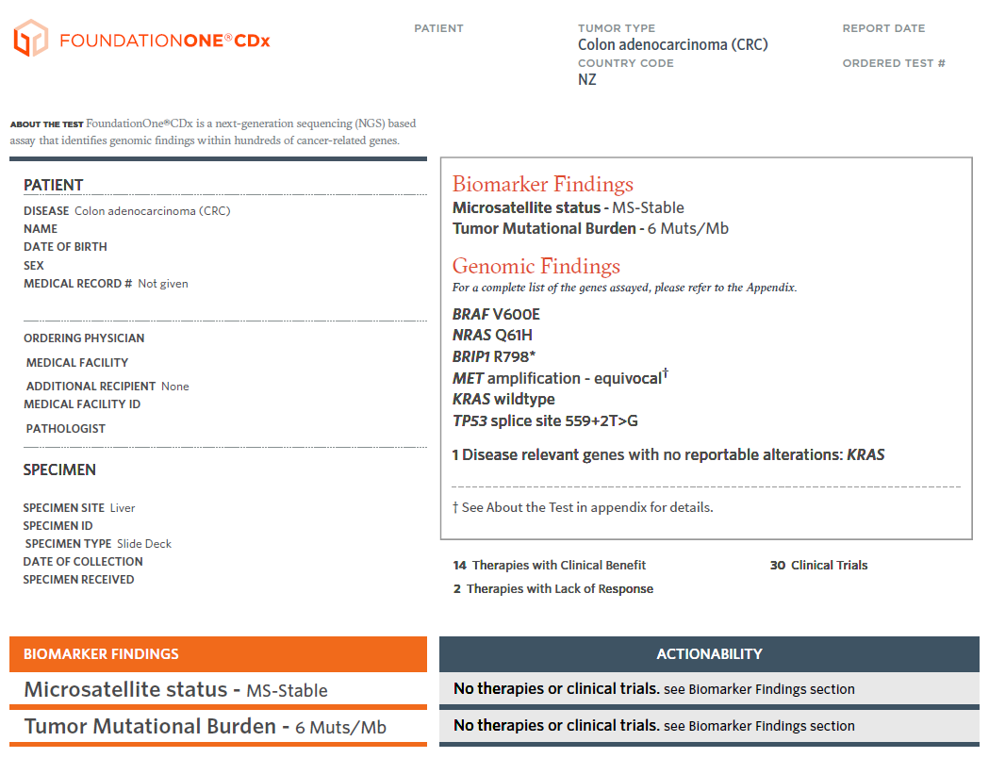
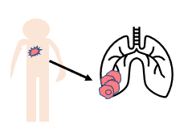
PDF report provided
43 y old, male
Metastatic CRC
What types of variants can be detected in tumour tissue?
Germline only
Somatic only
Germline and somatic
?

Slide 13
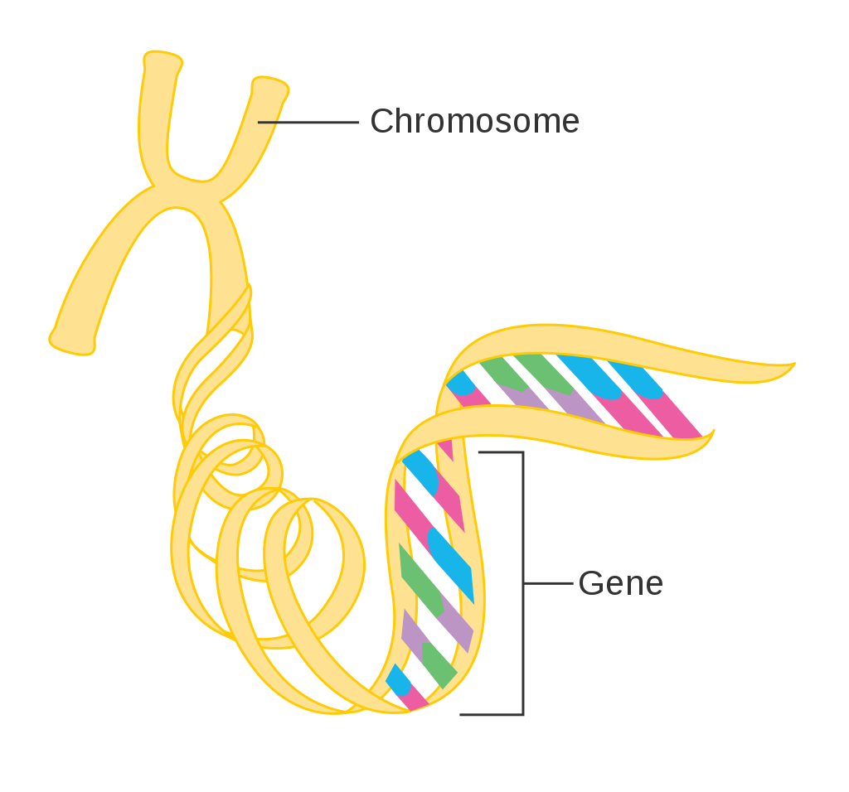
The genome
23 chromosome pairs
̴ 3.12x10⁹ base pairs A-T, C-G
A
A
C
C
T
T
G
G
̴ 21,000 protein coding genes
Mitochondrial DNA
From: CRUK Cancer Research UK, CC BY-SA 4.0
Genome: all the genes and non-coding DNA between genes
Exome (coding parts of 21,000 genes): 1-2% of the genome

Slide 14
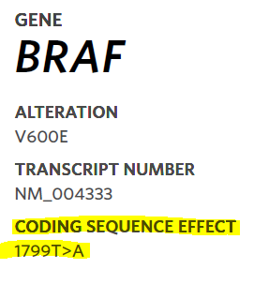
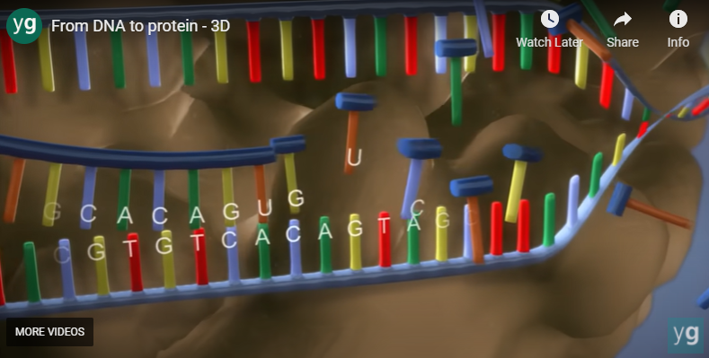
From: CRUK Cancer Research UK, CC BY-SA 4.0
Gene
Protein coding
Non-coding
Genomic DNA
Exon 1
Intron 1
Exon 2
Intron 2
Exon 3
pre-mRNA
Transcription
AG
GT
AG
GT
AG
GT
Exon 1
Intron 1
Exon 2
Intron 2
Exon 3
Splice sites
Splicing
mRNA
Un Translated Region
Exon 1
Exon 2
Exon 3
Coding DNA Seq. (CDS)
p.4 (FoundationOneCDx)
https://www.yourgenome.org/video/from-dna-to-protein

Slide 15
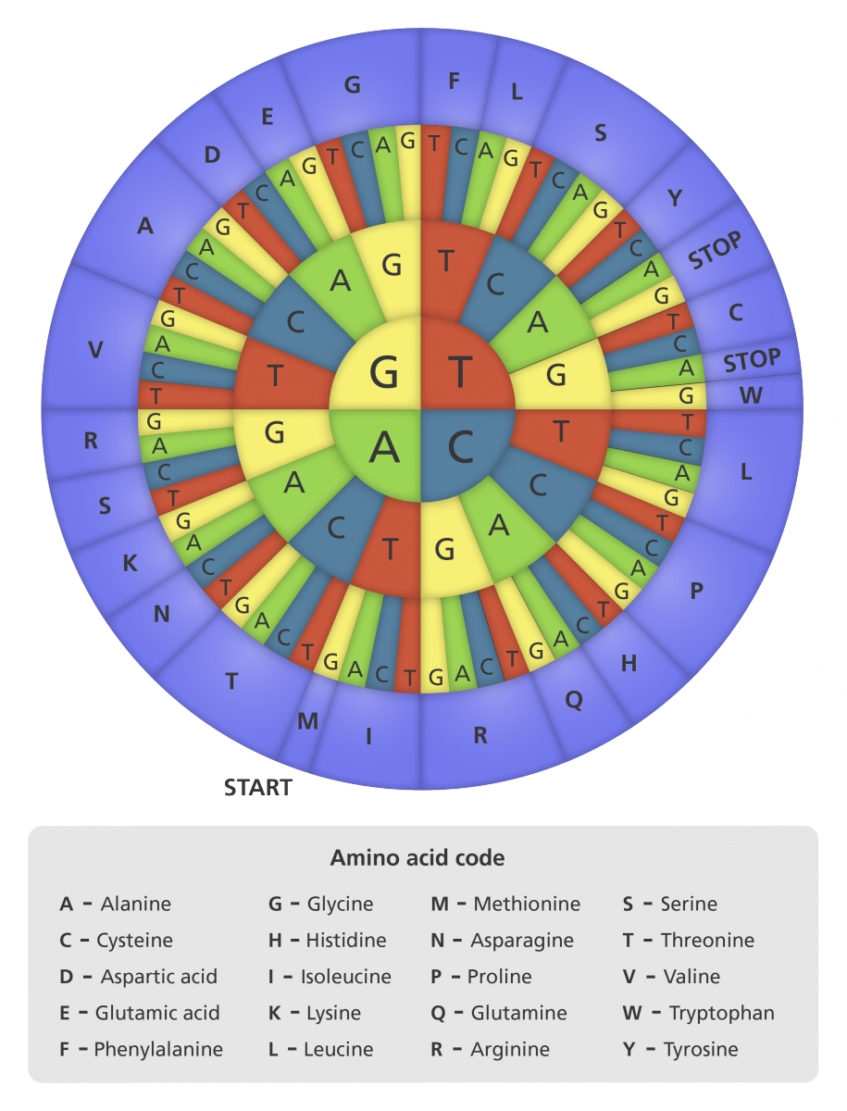
Chromosome pic from: CRUK Cancer Research UK, CC BY-SA 4.0
Gene
Protein coding
Non-coding
Genomic DNA
AG
GT
AG
GT
AG
GT
Exon 1
Intron 1
Exon 2
Intron 2
Exon 3
Splice sites
Transcription & splicing
mRNA
ATG GAG GAG CCG CAG …………………....... TAA
Translation
From: https://www.yourgenome.org/facts/what-does-dna-do CC-BY License

Slide 16
From: CRUK Cancer Research UK, CC BY-SA 4.0
Gene
Protein coding
Non-coding
Genomic DNA
AG
GT
AG
GT
AG
GT
Exon 1
Intron 1
Exon 2
Intron 2
Exon 3
Splice sites
mRNA
?
ATG GAG GAG CCG CAG …………………....... TAA
Translation
Met
Glu
Glu
Pro
Gln
Stop
Protein
p.4 (FoundationOneCDx)
From: https://www.yourgenome.org/facts/what-does-dna-do CC-BY License

Slide 17
Session 1: Essential genetics and genomics for clinical practice | Time
Introduction: Genomics & genetics in the clinics | 5
Essential genomics: Germline & Somatic variants (mutations) Terminology: variant & mutation & polymorphism Structure of the genome: protein coding & noncoding regions, exons & introns, Untranslated Regions (5' and 3' UTR) Gene transcription, splicing and translation | 10
Types of molecular alterations: Aneuploidy, Copy Number Variants (CNVs), Structural rearrangements Small variants Concepts in cancer: Oncogenes and Tumour Suppressor Genes | 10
Variant nomenclature standards (HGVS): g., c., p., transcript IDs (demo using Case 1 Foundation report) Alternative splicing giving rise to multiple isoforms from a single gene and how this is related to variant nomenclature (explain using the BRAF p.V600E example) | 10

Slide 18
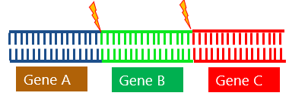
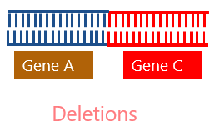
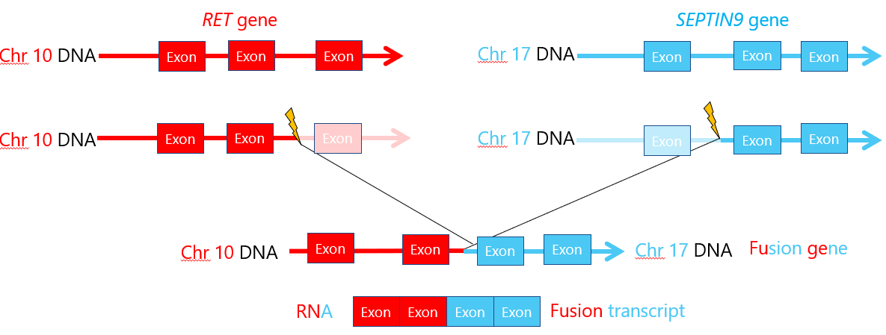
Large molecular alterations
Aneuploidy
Copy Number Variants (CNVs)
Loss of Heterozygosity (LOH) with Copy Loss
Haploid (monosomy)
Diploid (normal)
Triploid (trisomy)
NORMAL
Cancers cells can lose one allele
TUMOUR
deletions
gains/amplifications
20, 100…500 copies
germline
somatic
Structural rearrangements
NORMAL
inversion
TUMOUR
Translocations
Complex – multiple simultaneous events
fusion
Adapted from The Jackson Laboratory site: https://tumorfusions.org/ / TCGA Fusion Gene Database

Slide 19
Small alterations: Single Nucleotide Variants
AG
GT
AG
GT
AG
GT
Exon 1
Intron 1
Exon 2
Intron 2
Exon 3
Genomic DNA
Splice sites
mRNA (‘coding DNA sequence’)
ATG … … …. … … … GAG … … … … … … … TAA
ATG … … …. … … … GTG … … … … … … … TAA
Translation
Protein
Met
Val
Stop
Glu
Protein
Missense
Silent
Splice
p.4 (FoundationOneCDx)
From: https://www.yourgenome.org/facts/what-does-dna-do CC-BY License

Slide 20
Small alterations: Single Nucleotide Variants
AG
GT
AG
GT
AG
GT
Exon 1
Intron 1
Exon 2
Intron 2
Exon 3
Genomic DNA
Splice sites
mRNA (‘coding DNA sequence’)
ATG … … …. … … … TAA … … … … … … … TAA
ATG … … …. … … … TAC … … … … … … … TAA
Translation
Protein
Met
Tyr
Stop
Stop
Protein
Missense
Nonsense
Silent
Splice
From: https://www.yourgenome.org/facts/what-does-dna-do CC-BY License

Slide 21
Small alterations: Deletions or Insertions
AG
GT
AG
GT
AG
GT
Exon 1
Intron 1
Exon 2
Intron 2
Exon 3
Genomic DNA
Splice sites
mRNA (‘coding DNA sequence’)
ATG … … …. … AGC TAC CGG … … … … TAA
ATG … … …. … AGC TAC CGG … … … … TAA
ATG … … …. … AGC TCG G … … … … TAA
Translation
Protein
Met
Ser
Tyr
Arg
Stop
Ser
Protein
Frameshift
In-frame
From: https://www.yourgenome.org/facts/what-does-dna-do CC-BY License

Slide 22
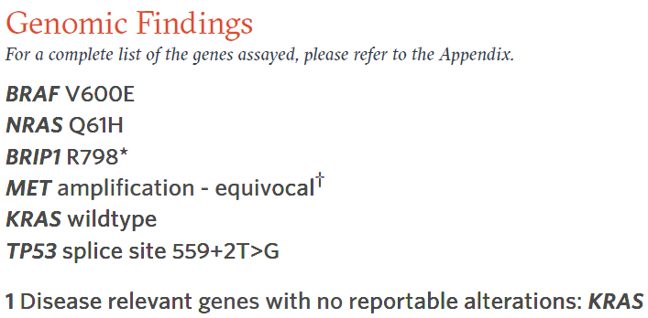
Molecular alterations in case
43 y old, male
Metastatic CRC
Identify CNVs (Copy Number Variants)
NORMAL
TUMOUR
deletions
gains/amplifications
20, 100…500 copies

Slide 23
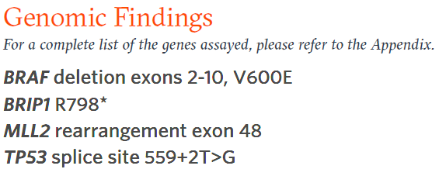
Molecular alterations in case
43 y old, male
Metastatic CRC
Identify CNVs (Copy Number Variants)
NORMAL
TUMOUR
deletions
gains/amplifications
20, 100…500 copies
BRAF gene (transcript NM_004333)
Intron 1
?
Exon 1
Exon 2
Exon 11
cca 138,000 DNA nucleotides deleted

Slide 24
Variants contributing to tumors
Oncogenes
Tumour suppressor genes
Cancer-promoting
Cancer Inhibiting
Chromosome 7
Chromosome 17
BRCA1
Aneuploidy
Loss of Heterozygosity
BRAF p.V600E
BRAF (normal/ wild type)
BRCA1 p.Gln563Ter
A variant in BOTH copies of a tumour suppressor gene can lead to cancer
Turns on an accelerator for tumour growth

Slide 25
Session 1: Essential genetics and genomics for clinical practice | Time
Introduction: Genomics & genetics in the clinics | 5
Essential genomics: Germline & Somatic variants (mutations) Terminology: variant & mutation & polymorphism Structure of the genome: protein coding & noncoding regions, exons & introns, Untranslated Regions (5' and 3' UTR) Gene transcription, splicing and translation | 10
Types of molecular alterations: Aneuploidy, Copy Number Variants (CNVs), Structural rearrangements Small variants Concepts in cancer: Oncogenes and Tumour Suppressor Genes | 10
Variant nomenclature standards (HGVS): g., c., p., transcript IDs (demo using Case 1 Foundation report) Alternative splicing giving rise to multiple isoforms from a single gene and how this is related to variant nomenclature (explain using the BRAF p.V600E example) | 10

Slide 26
Variant nomenclature
Chromosome 7
Chr7:g.140,453,136A>T
genomic pos140453136A>T
on chr 7, A replaced with T
BRAF genomic DNA
Exon 14
Intron 14
….TTT CTC TGT
Intron 15
Exon 16
….TTT CAC TGT
NM_004333.5:c.1799T>A
Coding DNA position 1799 in gene, T replaced with A
Transcription & Splicing
Coding DNA (mRNA)
5’UTR
ATG
….ACA GTG AAA
TAA
….ACA GAG AAA
………..
3’UTR
Translation
Protein
p.V600E (p.Val600Glu)
Valine in position 600 of protein replaced with Glutamic acid
M
E
Stop
V

Slide 27
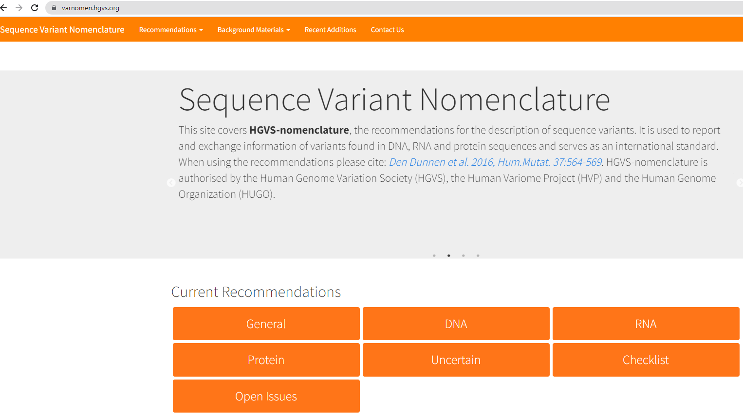
https://varnomen.hgvs.org/

Slide 28
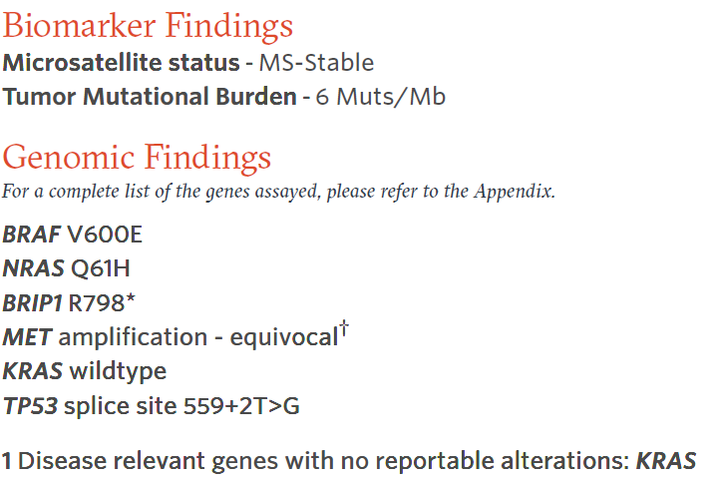
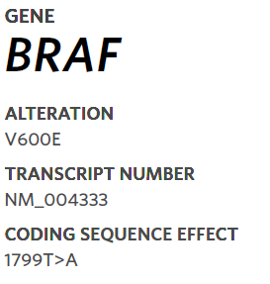
Variant nomenclature (Foundation One)
What class of variant is this?
Missense
Synonymous
Nonsense
Frameshift
Splicing
What class of variant is this?
Missense
Synonymous
Nonsense
Frameshift
Splicing
FFPE report page 1
page 4
Gene | Coding DNA | Protein | Transcript | Variant class
BRAF | c.1799T>A | p.(V600E) p.(Val600Glu) | NM_004333 | MISSENSE
 | (T) thymine at position 1799 is replaced by (A) adenine | Valine is replaced by Glutamic acid at position 600

Slide 29
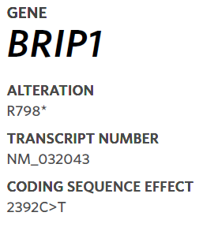
Variant nomenclature (Foundation One)
What class of variant is this?
Missense
Synonymous
Nonsense
Frameshift
Splicing
What class of variant is this?
Missense
Synonymous
Nonsense
Frameshift
Splicing
FFPE report page 1
page 5
Gene | Coding DNA | Protein | Transcript | Variant class
BRIP1 | c.2392C>T | p.(R798*) | NM_032043 | NONSENSE
 | (C) cytosine at position 2392 is replaced by (T) thymine | Arginine (Arg) is replaced by a STOP codon at position 798

Slide 30
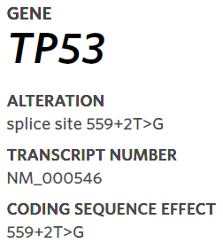
Variant nomenclature (Foundation One)
What class of variant is this?
Missense
Synonymous
Nonsense
Frameshift
Splicing
What class of variant is this?
Missense
Synonymous
Nonsense
Frameshift
Splicing
FFPE report page 1
page 7
Gene | Coding DNA | Protein | Transcript | Variant class
TP53 | c.559+2T>G | p.? | NM_000546.6 | Splicing
 | (T) thymine at position 2 nt further from pos.c.599 is replaced by (G)

Slide 31
Variant nomenclature (Foundation One)
What class of variant is this?
Missense
Synonymous
Nonsense
Frameshift
Splicing
What class of variant is this?
Missense
Synonymous
Nonsense
Frameshift
Splicing
FFPE report page 1
page 7
NM_000546.6:c.559+2T>G p.?
TP53 Exon 5
TP53 Intron 5

Slide 32
Variant nomenclature – transcript matters
Variant in genomic DNA chr7:g.140453136A>T
NM_001374258.1:c.1919T>A p.V640E
NM_004333.6:c.1799T>A p.V600E

Slide 33
